Slide 1
Until Debt Do Us Part
Notes:
Dental School education is an expensive undertaking. An extreme few are fortunate enough to have adequate resources to pay for this education, but unfortunately, most of you will probably have a large student debt to pay off once you graduate. That is why it is important to plan your student debt wisely.

Slide 2
Where Most Students End Up
Notes:
Unfortunately, due to the high cost of a dental education and the lack of time to utilize part-time jobs causes most dental students to literally be behind the eight ball on their education.

Slide 3
Graduates in Trouble
 |  | 2008 | 2009 | 2010 | 2011
Entering Debt |  | $ 31,775 | $ 35,281 | $ 31,101 | $ 35,670
Graduating Debt
 | All Schools | $ 170,367 | $ 173,582 | $ 178,054 | $180,557
 | Public | $ 142,671 | $ 149,555 | $ 157,973 | $157,525
 | Private and Private/State Related | $ 204,734 | $ 208,921 | $ 209,740 | $218,695
Source: ADEA Survey of Dental School Seniors 2011 Graduating Class
Notes:
Almost 90% of dental students graduate with debt. Over 77% of graduates have more than $100,000 in debt and over 44% have more than $200,000 in debt.

Slide 4
What’s Available Out There
 | 2005 | 2006 |  | 2010 | 2011
Loan Use | 93.1 | 93 |  | 93 | 93
Type of Loan
- Health Professions Student Loan | 31.6 | 32.9 |  | 27.8 | 24.9
- Perkins Loan | 31.7 | 32.6 |  | 24.3 | 21.6
- Stafford Loan Program | 82.6 | 84.1 |  | 80.1 | 79.6
- Personal Bank Loans | 9.1 | 10.3 |  | 13.8 | 9.9
- Family/Relative Loans | 16.3 | 15.9 |  | 6.8 | 5.6
- Unsubsidized Stafford Loan | 78.5 | 80.2 |  | 77.2 | 76.2
- Alternative Dental Ed. Assistance Loan | 26.6 | 26.5 |  | N/A | N/A
- Disadvantaged Student Loan | 4.1 | 5.1 |  | 2.7 | 3.0
- Credit Card | 10.7 | 10.1 |  | N/A | N/A
Source: ADEA Survey of Dental School Seniors 2011 Graduating Class

Slide 5
What’s Available Out There
 | 2005 | 2006 |  | 2010 | 2011
Loan Use | 93.1 | 93 |  | 93 | 93
Type of Loan
- Health Professions Student Loan | 31.6 | 32.9 |  | 27.8 | 24.9
- Perkins Loan | 31.7 | 32.6 |  | 24.3 | 21.6
- Stafford Loan Program | 82.6 | 84.1 |  | 80.1 | 79.6
- Personal Bank Loans | 9.1 | 10.3 |  | 13.8 | 9.9
- Family/Relative Loans | 16.3 | 15.9 |  | 6.8 | 5.6
- Unsubsidized Stafford Loan | 78.5 | 80.2 |  | 77.2 | 76.2
- Alternative Dental Ed. Assistance Loan | 26.6 | 26.5 |  | N/A | N/A
- Disadvantaged Student Loan | 4.1 | 5.1 |  | 2.7 | 3.0
- Credit Card | 10.7 | 10.1 |  | N/A | N/A
Source: ADEA Survey of Dental School Seniors 2008 Graduating Class

Slide 6
Apples to Apples
 | Grad Stafford | Grad Private | Grad Plus
Annual Limits | Up to $20,500/yr. | Cost less other aid | Cost less other aid
Checks Sent | To School | To School | To School
Cosigner | No | Optional | No
Approval Basis | Need (based on FAFSA) | Credit (no FAFSA required) | Credit (FAFSA usually required)
Rates | Fixed at 6.8% | Variable –credit based | Fixed at 7.9%
Repayment | Up to 25 Years | Up to 20 Years | Up to 25 Years

Slide 7
Rules for Debt Management

Slide 8
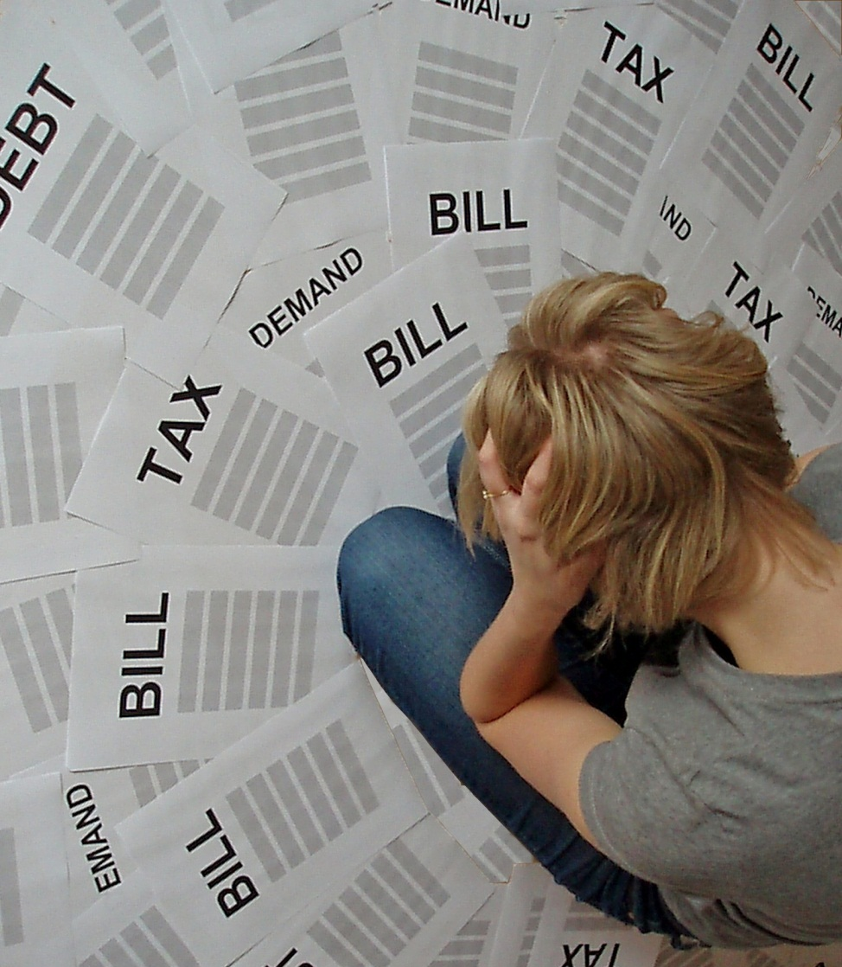
Rules for Debt Management
Borrow only what you need

Slide 9
Borrow Only What You Need
Banks lend what they are confident you can repay
Aggregate Stafford loan amount for educational expenses from undergraduate through dental school is $224,000. Financial Aid will only pay for student’s own basic expenses
Standard Cost of Attendance (COA) is estimate of student’s educational expenses during enrollment
Total aid student receives cannot exceed COA
Student may request Personal COA for some basic needs

Slide 10
Borrow Only What You Need
Banks lend what they are confident you can repay
Constructing a budget is crucial
Individuals who budget have 20% more spendable income than those that don’t

Slide 11
Develop A Budget
Direct Costs
Tuition and Fees
Computer, Books, and Supplies
Indirect Costs
Insurance
Room and Board
Transportation
Personal Expenses
Loan Fees

Slide 12
Dental School Budget Freshman Year
Categories | 1st Semester | 2nd Semester | Total for Year
Tuition and Fees | $ 10,128 | 10,128 | $ 20,256
Books and Supplies | $ 10,200 |  | $ 10,200
Insurance | $ 1,457 | $ 1,457 | $ 2,914
Rent | $ 4,200 | $ 4,200 | $ 8,400
Food | $ 1,600 | $ 1,600 | $ 3,200
Utilities | $ 620 | $ 620 | $ 1,240
Transportation | $ 1,900 | $ 1,900 | $ 3,800
Personal | $ 1,600 | $ 1,600 | $ 3,200
TOTAL |  |  | $ 53,210

Slide 13
Dental School Budget Sophomore Year
Categories | 1st Semester | 2nd Semester | Total for Year
Tuition and Fees |  |  | $20,650
Books and Supplies |  |  | $ 6,600
Insurance | $ 1,460 | $ 1,460 | $ 2,920
Rent | $ 4,200 | $ 4,200 | $ 8,400
Food | $ 1,600 | $ 1,600 | $ 3,200
Utilities | $ 620 | $ 620 | $ 1,240
Transportation | $ 1,900 | $ 1,900 | $ 3,800
Personal | $ 1,600 | $ 1,600 | $ 3,200
TOTAL |  |  | $ 50,010

Slide 14
Borrow Only What You Need
Banks lend what they are confident you can repay
Constructing a budget is crucial
Borrowing now affects borrowing later
It affects your future earnings
Debt affects your personal life

Slide 15
Life-Changing Effects of Debt
Starts in college
It increases stress – affects your health
Relationships are affected
Families are emotionally devastated
Performance affected
Next generation
Chance to enjoy life

Slide 16
Borrow Only What You Need
Banks lend what they are confident you can repay
Constructing a budget is crucial
Borrowing now affects borrowing later
It affects your future earnings
Debt affects your personal life
You cannot walk away from the debt

Slide 17
Default and Delinquency
Delinquency is a late payment
Several of these can affect your credit rating
Default means 270 days of repayment delinquency
This will affect your credit and possibly jeopardize your license in some states
Student loan debt is on a par with child support and overdue taxes
It is not excused by bankruptcy
Federal government can garnish wages and Social Security

Slide 18
Time Value of Money

Slide 19
Understanding the Effects of Interest Future Value of Current Dollar

Slide 20
The Rule of 72
A quick and easy way to determine the effect of compounding
It determines the number of years for your money, or when borrowing, the amount paid, to double
The time for your money to double is 72 divided by the interest rate

Slide 21
Understanding Student Loan Debt
Stafford loans charge a fixed rate of 6.80% for any new loans as of 7/1/2006
Subsidized funds do not accrue interest while you are in school
The maximum subsidized amount per academic year is $8,500
Unsubsidized funds accrue interest while you are in school (maximum per year is $36,667)
If possible, pay quarterly interest statement

Slide 22
Loan Repayment

Slide 23
Loan Repayments Monthly Payments on $1,000
 | 4% | 6% | 8% | 10% | 12%
5 | 18.42 | 19.33 | 20.28 | 21.25 | 22.24
6 | 15.65 | 16.57 | 17.53 | 18.53 | 19.55
7 | 13.67 | 14.61 | 15.59 | 16.60 | 17.65
8 | 12.19 | 13.14 | 14.14 | 15.17 | 16.25
9 | 11.04 | 12.01 | 13.02 | 14.08 | 15.18
10 | 10.12 | 11.10 | 12.13 | 13.22 | 14.35
11 | 9.38 | 10.37 | 11.42 | 12.52 | 13.68
12 | 8.76 | 9.76 | 10.82 | 11.95 | 13.13
13 | 8.23 | 9.25 | 10.33 | 11.48 | 12.69
14 | 7.78 | 8.81 | 9.91 | 11.08 | 12.31
15 | 7.40 | 8.44 | 9.56 | 10.75 | 12.00
Years

Slide 24
Payback is Tough
Student A
Student B
Amount Borrowed $85,000
Length of Loan (years) 10
Interest Rate 6%
Monthly Payment $943.50
Total Amount Paid $113,220
$100,000
10
6%
$1,110.10
$133,200
The larger the loan, the greater the impact on monthly cash flow. This difference can
be controlled by extending the term, or time of payment.

Slide 25
Payback is Tough
Student B
Student A
Amount Borrowed $100,000
Length of Loan (years) 10
Interest Rate 6%
Monthly Payment $1,110.10
Total Amount Paid $133,200
$100,000
15
6%
$ 844.00
$151,920
Although the monthly payment is lower, since we are paying for a longer period, the total amount paid is greater.

Slide 26
Rules of Debt Management
Borrow only what you need
Develop a budget
Keep good records

Slide 27
Records to Keep
Loan applications
Interest rate
Capitalization
Fees
Information about:
Grace
Deferment
Forbearance
Promissory notes
Correspondence from lenders

Slide 28
Rules of Debt Management
Borrow only what you need
Develop a budget
Keep good records
Look into part-time jobs

Slide 29
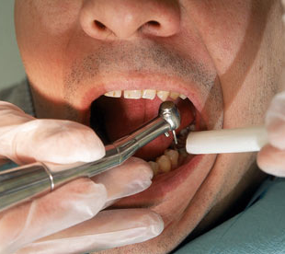
Rules of Debt Management
Borrow only what you need
Develop a budget
Keep good records
Look into part-time jobs
Consider a service-connected repayment program

Slide 30
Service Connected Programs
Public Health Services
www.usphs.gov
Navy
www.navy.com
Air Force
www.airforce.com
Army
www.goarmy.com
U.S. Department of Veterans Affairs
www.va.gov

Slide 31
Rules of Debt Management
Borrow only what you need
Develop a budget
Keep good records
Look into part-time jobs
Consider a service-connected repayment program
Avoid consumer debt

Slide 32
Protect Against Identity Theft

Slide 33
Preventing Identity Theft
Shred anything with your name or address on it
Use a cross-cut shredder
Shred any promotional materials for credit
Passwords should consist of numbers and both upper case and lower case letters
When in doubt, pay in cash
Be aware of your surroundings

Slide 35
The Happy Day

Slide 36
Practice Options
Solo Practice
Group Practice
Associateships
Post-graduate programs
Military
Public Health
Teaching

Slide 37
Where Do Grads Go?
Plans | 1985 | 1995 | 2005 | 2008
Solo/Private Practice | 9.4% | 5.8% | 3.7% | 3.1%
Partner Group | 14.3% | 11.1% | 6.1% | 6.7%
Associate/Employed | 34.4% | 32.9% | 41.8% | 40.6%
Total Private Practice | 58.1% | 49.8% | 51.6% | 50.4%
Government Service | 10.3% | 8.9% | 6.1% | 5.9%
Teaching/Research/Administration | 0.9% | 1.1% | 0.8% | 0.8%
Advanced Education | 23.6% | 36.0% | 38.6% | 39.6%
Undecided | 7.2% | 4.2% | 3.0% | 3.3%
Source: American Dental Association

Slide 38
Where Do Grads Go?
Plans | 1985 | 1995 | 2005 | 2008
Solo/Private Practice | 9.4% | 5.8% | 3.7% | 3.1%
Partner Group | 14.3% | 11.1% | 6.1% | 6.7%
Associate/Employed | 34.4% | 32.9% | 41.8% | 40.6%
Total Private Practice | 58.1% | 49.8% | 51.6% | 50.4%
Government Service | 10.3% | 8.9% | 6.1% | 5.9%
Teaching/Research/Administration | 0.9% | 1.1% | 0.8% | 0.8%
Advanced Education | 23.6% | 36.0% | 38.6% | 39.6%
Undecided | 7.2% | 4.2% | 3.0% | 3.3%
Source: American Dental Association

Slide 39
Where Do Grads Go?
Plans | 1985 | 1995 | 2005 | 2008
Solo/Private Practice | 9.4% | 5.8% | 3.7% | 3.1%
Partner Group | 14.3% | 11.1% | 6.1% | 6.7%
Associate/Employed | 34.4% | 32.9% | 41.8% | 40.6%
Total Private Practice | 58.1% | 49.8% | 51.6% | 50.4%
Government Service | 10.3% | 8.9% | 6.1% | 5.9%
Teaching/Research/Administration | 0.9% | 1.1% | 0.8% | 0.8%
Advanced Education | 23.6% | 36.0% | 38.6% | 39.6%
Undecided | 7.2% | 4.2% | 3.0% | 3.3%
Source: American Dental Association

Slide 40
How Much Debt Can I Handle?

Slide 41
The Debt Test

Slide 42
The Rules
STOP SPENDING!

Slide 43
The Cold Hard Facts
96% of all Americans will be financially dependent on the government, family, or charity at retirement
Americans, on average, can expect to receive only 37% of the amount they will need to live comfortably from their retirement plan
Nearly half of all Americans have less than $10,000 saved for retirement
Only 2% of homes are paid for entirely

Slide 44
The Rules
STOP SPENDING!
Quit using credit cards

Slide 45
The Cold Hard Facts – Part Two
There are 1.3 billion payment cards in the U.S.
Americans make over $3 trillion dollars of purchases annually
The typical credit card purchase is 112% higher than if using cash
Americans carry, on average, $8,400 in credit card debt
Average U.S. household pays $950 in interest annually

Slide 46
What is a Credit Score?

Slide 47
What is a Credit Score?
There is no one set FICO score
Each lender is allowed to adjust it to their needs
A separate FICO score is also given by the different credit agencies
FICO scores range from 300 – 850
About 10% of lenders use Vantage-Score which ranges from 501 – 990
Most importantly for loans is to know what your lender uses

Slide 48
Dissecting Your Credit Score
Recently opened accounts and the proportion of these to established ones affect your score.

Slide 49
Can I Improve My Score?
Make your payments on time
Set up automatic payments to creditors
Pay down debt and don’t move it around
If you have a short credit history, don’t open new accounts too rapidly
A large number of new accounts hurts your score
Don’t close unused accounts
The longer you’ve had a credit line, the better
Have as large a credit line as possible
Check your credit report

Slide 50
The Value of a High Score
30-Year Fixed Mortgage
FICO Score | Annual Percentage Rate* | Monthly Payment
760-850 | 4.361% | $1,495
700-759 | 4.583% | $1,535
680-699 | 4.760% | $1,567
660-679 | 4.974% | $1,606
640-659 | 5.404% | $1,685
620-639 | 5.950% | $1,789
Interest rates are as of May 9, 2011.
Sources: Fair Isaac Corporation (myfico.com);
Informa Research Services.

Slide 51
Check Your Credit Annually
Equifax
www.equifax.com
Experian
www.experian.com
Trans Union
www.transunion.com
www.annualcreditreport.com

Slide 52
The Rules
STOP SPENDING!
Quit using credit cards
Act your tax bracket!

Slide 53
Dentist’s Gross Billings
Notes:
The gross billings reported by solo dentists do not take inflation into consideration. To do so, real gross billings were calculated using 2005 as the base year. Table 78 shows the reported mean gross billings and real mean gross billings from survey years 2006-2010 for solo general practitioners, solo specialists, and all solo dentists.
Average gross billings for solo dentists decreased when inflation was considered. From 2005 to 2009, real gross billings for all solo dentists decreased by an average annual rate of 0.3%; for solo general practitioners, 0.4%; and for solo specialists, 0.2%.

Slide 54
Dentist’s Net Income
Source: ADA Survey Center,
Surveys of Dental Practice
Notes:
The net income reported by independent nonsolo dentists does not take inflation into consideration. To do so, real income was calculated using 2005 as the base year. The table shows the reported mean income and real mean income from survey years 2006-2010 for independent nonsolo general practitioners, independent nonsolo specialists, and all independent nonsolo dentists.
Average net income decreased for independent nonsolo dentists when inflation was considered. From 2005 to 2009, real net income of all independent nonsolo dentists decreased at an average annual rate of 3.2%. Independent nonsolo general practitioners’ real net income decreased 3.8% per year on average while independent nonsolo specialists’ real net income decreased 2.0% per year, on average.

Slide 55
The Rules
STOP SPENDING!
Quit using credit cards
Act your tax bracket
Get organized

Slide 56
The Rules
STOP SPENDING!
Quit using credit cards
Act your tax bracket
Get organized
Set goals

Slide 57
Strategies for Goal Setting
Print your goal
Print reasons to accomplish the goal
List the obstacles
Identify the resources you will need
Formulate a plan of action
Place a completion date

Slide 58
The Rules
STOP SPENDING!
Quit using credit cards
Act your tax bracket
Get organized
Set goals
Be reasonable in your expectations

Slide 59
Eliminating Debt Areas to Review
Income sources

Slide 60
Eliminating Debt Areas to Review
Income sources
Insurance policies

Slide 61
Eliminating Debt Areas to Review
Income sources
Insurance policies
Mortgage schedule

Slide 62
Eliminating Debt Areas to Review
Income sources
Insurance policies
Mortgage schedule
Credit card purchases

Slide 63
Eliminating Debt Areas to Review
Income sources
Insurance policies
Mortgage schedule
Credit card purchases
Transportation

Slide 64
Eliminating Debt Areas to Review
Income sources
Insurance policies
Mortgage schedule
Credit card purchases
Transportation
Children

Slide 65
Eliminating Debt Areas to Review
Income sources
Insurance policies
Mortgage schedule
Credit card purchases
Transportation
Children
Entertainment

Slide 66
Does Consolidation Work?
Notes:
Consolidation is becoming an increasingly common practice among students in debt. Many times I liken this to instead of taking a bunch of little pills to taking one big pill. Sure, there are fewer pills to swallow, but can you now swallow the one big pill? It reduces the monthly payment but increases the total amount that must be paid as it extends the length of the repayment period.
If a student borrowed $10,000 at 7 percent interest over 10 years, he’d pay $116 a month or a total of $13,933 in principal and interest. Stretch that to 15 years, and he pays $90 a month, but now pays a total of $16,178. Rates on consolidation loans are figured by averaging the rates of all of a graduate’s loans, up to an 8.25 percent maximum.
Graduates need to also know that they may lose their federal subsidy if they consolidate a Perkins Loan.While consolidation can reduce payments to a more manageable level, it only serves to ease, not eliminate, the pain.
Another repayment option is to seek more flexible terms. Some lenders will lower the interest rate a borrower must pay if the borrower makes timely payments for 48 months, or agrees to pay by electronic transfer from a bank account.
Congress also helps by extending a helping hand by making up to $1,000 in student loan interest tax deductible for borrowers who meet certain income requirements and are in the first 60 months of repayment. Single income tax filers earning less than $40,000 and couples earning less than $60,000 are eligible. However, the consequences of failing to make timely payments can be severe. The government can garnishee tax rebates, paychecks and checking and savings accounts. Defaulting stays on your credit record for up to seven years

Slide 67
Does Consolidation Work?
Allows borrower to combine several loans into one
It works if:
Lower fixed interest rate
One lender/One payment
Flexible repayment options
Reduced monthly payment
Consult www.loanconsolidation.ed.gov

Slide 68
The BIG Mistake Is bankruptcy the answer?
Emotionally devastating
Assets will be sold to satisfy debts
All debts are not discharged
Bankruptcy only protects YOU

Slide 69
The Rules
STOP SPENDING!
Quit using credit cards
Act your tax bracket
Get organized
Set goals
Be reasonable in your expectations
Set up a budget

Slide 70
The Rules
STOP SPENDING!
Quit using credit cards
Act your tax bracket
Get organized
Set goals
Be reasonable in your expectations
Set up a budget
Utilize a debt reduction schedule

Slide 71
Debt Reduction Schedule

Slide 73
Thank You

