Slide 1
The Evolution of Sedation in Dental Practice: From the Ridiculous to the Sublime
Joseph A. Giovannitti, Jr., DMD
Professor and Chair,
Department of Dental Anesthesiology
University of Pittsburgh School of Dental Medicine
ASDA’s Institute for the Management of Pain and Anxiety (IMPA)
In Collaboration with the Academy of General Dentistry
June 9 & 10, 2021

Slide 2
Disclosures
No financial disclosures
Representing the American Society of Dentist Anesthesiologist’s Institute for the Management of Pain and Anxiety
  ASDA/IMPA

Slide 3
Overview
A brief history of anesthesia in dentistry
Impact of the Guidelines on dental practice
Identifying potentially reactive patients prior to sedation
Problems specific to our aging population
Sedation considerations for the elderly
Presented by the ASDA’s Institute for the Management of Pain and Anxiety
Cutting-Edge Education for the Cutting-Edge Dental Professional

Slide 4
History of Anesthesia and Evolution of Sedation in Dental Practice
“A New Era in Tooth Pulling”

Slide 5
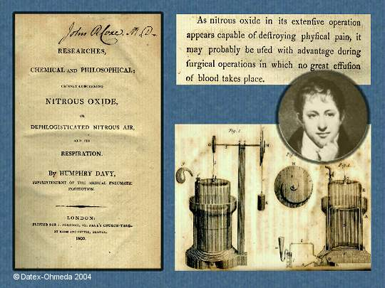
Sir Humphrey Davy
It All Began With Nitrous Oxide!

Slide 6
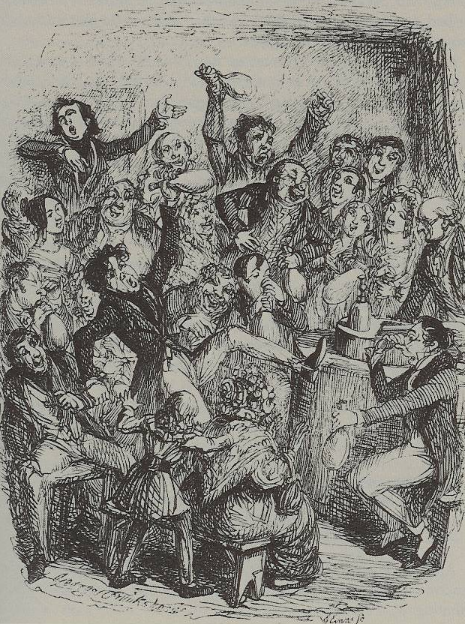
Nitrous Oxide ”Frolics”
London, 1830’s
Notes:
Humphrey Davy described the potential of nitrous oxide to relieve pain. This was ignored. Instead nitrous oxide became a popular recreational drug.

Slide 7
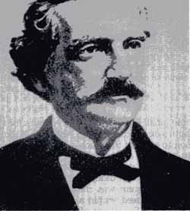
GARDNER QUINCY COLTON
Demonstrations of Nitrous Oxide for Public Entertainment

Slide 8
A Grand Exhibition of the effects produced by inhaling Nitrous Oxid, Exhilarating or Laughing Gas! will be given at Union Hall, this (Tuesday) Evening, Dec. 10th, 1844. Forty Gallons of Gas will be prepared and administered to all in the audience who desire to inhale it. Twelve Young Men have volunteered to inhale the Gas, to commence the entertainment. The entertainment will close with a few of the most surprising Chemical Experiments. Entertainment to commence at 7 o'clock. Tickets 25 cents—for sale at the principal Bookstores and at the Door. Eight Strong Men are engaged to occupy the front seats, to protect those under the influence of the Gas from injuring themselves or others. This course is adopted that no apprehension of danger may be entertained. Probably no one will attempt to fight. The effect of the Gas is to make those who inhale it either Laugh, Sing, Dance, Speak, or Fight, and so forth, according to the leading trait of their character. They seem to retain consciousness enough not to say or do that which they would have occasion to regret. The Gas will be administered only to gentlemen of the first respectability. The object is to make the entertainment in every respect a genteel affair.

Slide 9
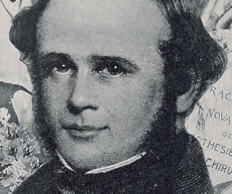
HORACE WELLS
The Discoverer of Anesthesia

Slide 10
December 10, 1844
" At length Sam Cooley took the gas and proved to be an interesting subject. He careened about the stage in an extraordinary manner when suddenly he espied in the audience an imaginary enemy and sprung over the ropes and after him. The innocent spectator, frightened out of his seven wits, summarily abandoned his seat and fled, running like a deer around the hall with Cooley in hot pursuit, the audience on its feet applauding in delight. The terrified victim finally dodged, vaulted over a settee and rushed down an aisle, Cooley a close second. Half way to the front the pursuer came to himself, looked about foolishly, and amid shouts of laughter and applause slid into his seat near to Dr. [Horace] Wells. Presently he was seen to roll up his trousers and gaze in a puzzled sort of way at an excoriated and bloody leg..."

Slide 11
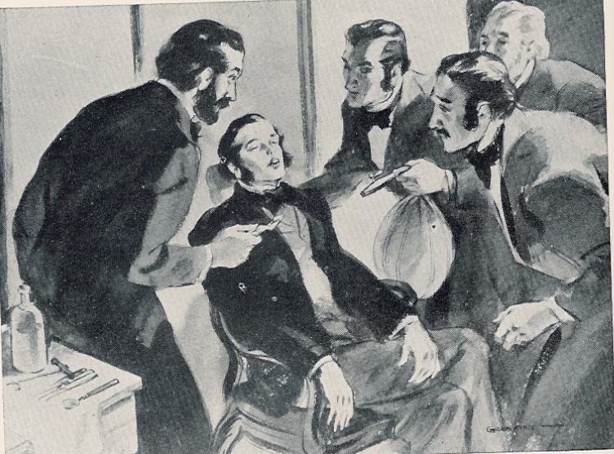
“A New Era in Tooth Pulling”
“I didn’t feel as much as a pinprick”

Slide 12
Dr. John Riggs
“Wells and I had a . . . conference that night & determination to try the gas on Wells the next morning. Wells went to the Hall & asked Colton to let him have a bag of gas as he wanted to take it and have a tooth pulled--& he invited the party, Colton, Cooley, and two others to come up and witness the operation. I was attending to a patient but was awaiting Wells' return. When I entered Wells' office, the said parties were there. Wells took his seat in the operating chair. I examined the tooth so as to be ready to operate without delay. Wells took the bag in his lap-held the tube to his mouth & inhaled till insensibility relaxed the muscles of his arms -his hands fell on his breast-his head dropped on the head-rest & I instantly, passed the forceps into the mouth onto the tooth and extracted it. Mr. Colton, Cooley and the two there stood by the open door ready to run out if Wells jumped up from the chair & made any hostile demonstrations. You may ask-Why did he not get up? Simply because he could not. Our agreement, the night previous was, to push the administration to a point hitherto unknown. We knew not whether death or success confronted us. It was terra incognito we were bound to explore-the result is known to the world. No one but Wells and myself knew to what point the inhalation was to be carried-the result was painfully problematical to us but the great law of Nature, hitherto unknown, was kind to us & a grand discovery was born into the world.

Slide 13
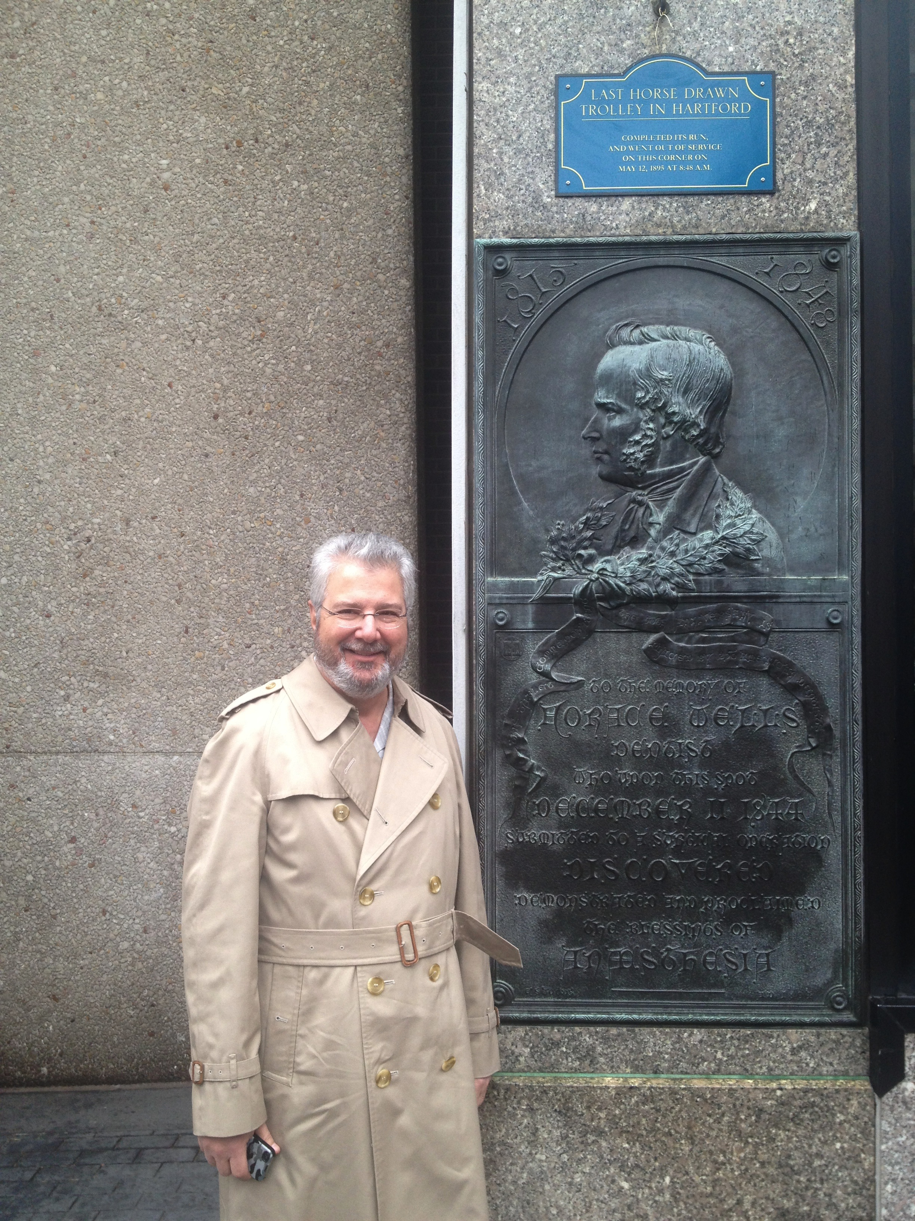

Slide 14
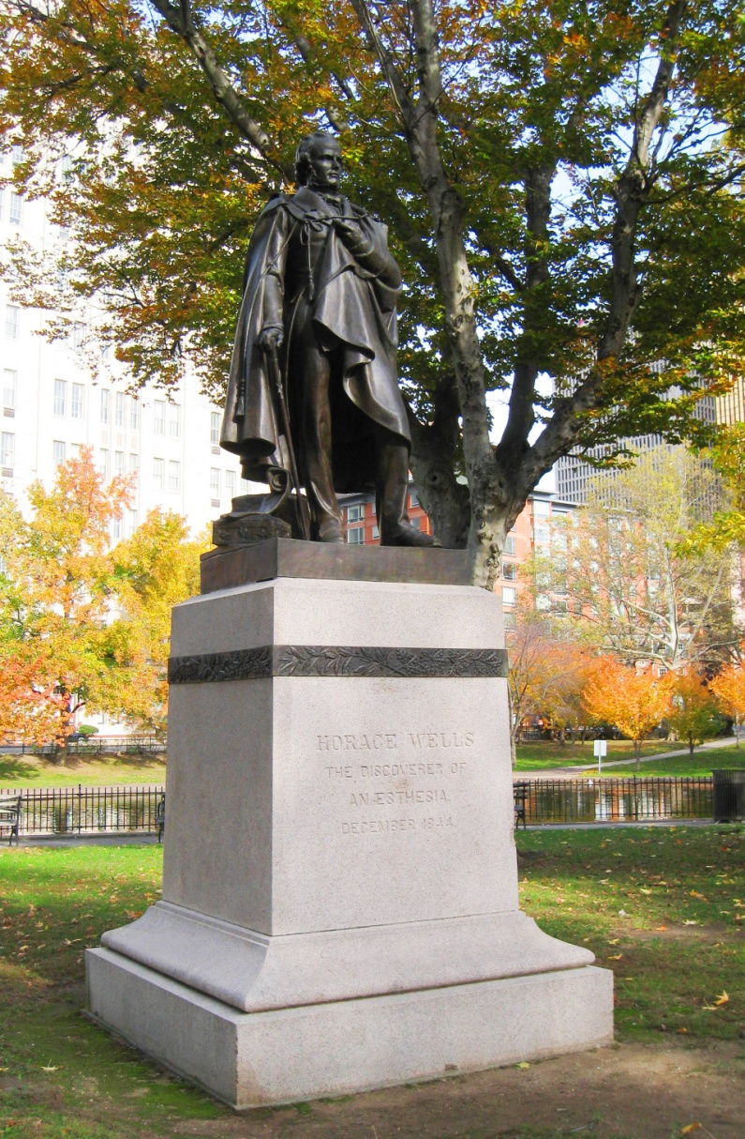
THE DISCOVERER OF ANESTHESIA

Slide 15
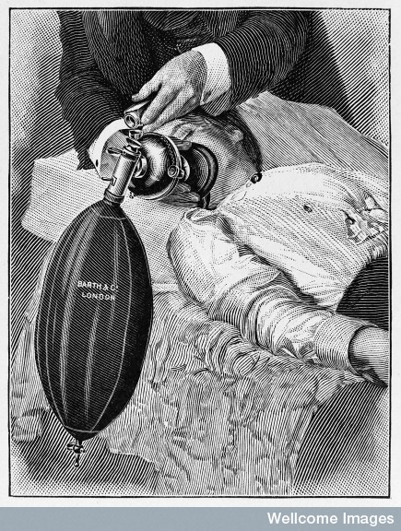
100% Technique
Cyanosis means more working time

Slide 16
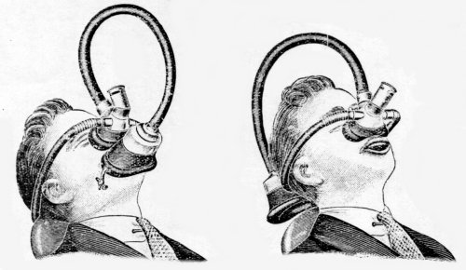

Slide 17
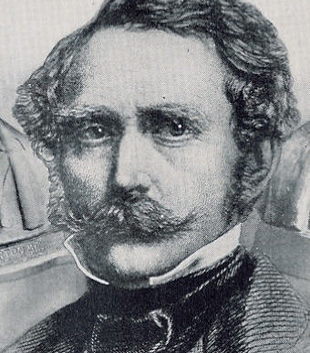
WILLIAM T.G. MORTON

Slide 18
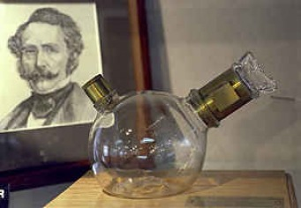
Morton’s Ether Inhaler

Slide 19
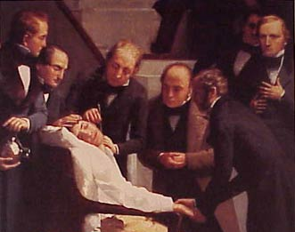
Ether Day
October 16, 1846
“Gentlemen, this is no humbug!”

Slide 20
Dr. Jay A. Heidbrink
Developed the “Heidbrink Anesthetizer”
Invented the “pin index” system
Developed the carbon dioxide absorber
Introduced “reducing valves” into anesthesia machines
Notes:
Dentists continued to be instrumental in the development of anesthesia for both medicine and dentistry.

Slide 21
Development of Intravenous Anesthesia
Dr. Stanley L. Drummond- Jackson
Edinburgh University Dental School, 1931
Pioneered the use of intravenous barbiturates for dental surgery
Notes:
Intravenous agents were used in a similar fashion to the way inhalational agents were used. A bolus dose of a barbiturate was given, the patient became unconscious and the teeth were removed as quickly as possible. Again, the best surgeons were the fastest surgeons.

Slide 22
Development of Intravenous Anesthesia
Dr. Adrian O. Hubbell
University of Southern California School of Dentistry, 1937
Adapted intravenous thiopental for oral surgery
First infusion pump
  Patented “Apparatus for Handling Fluids”
  “Hubbell Bubble”

Slide 23
Dr. Niels B. Jorgensen
Loma Linda University
  “Jorgensen Technique”
  Pentobarbital, meperidine, scopolamine

Slide 24
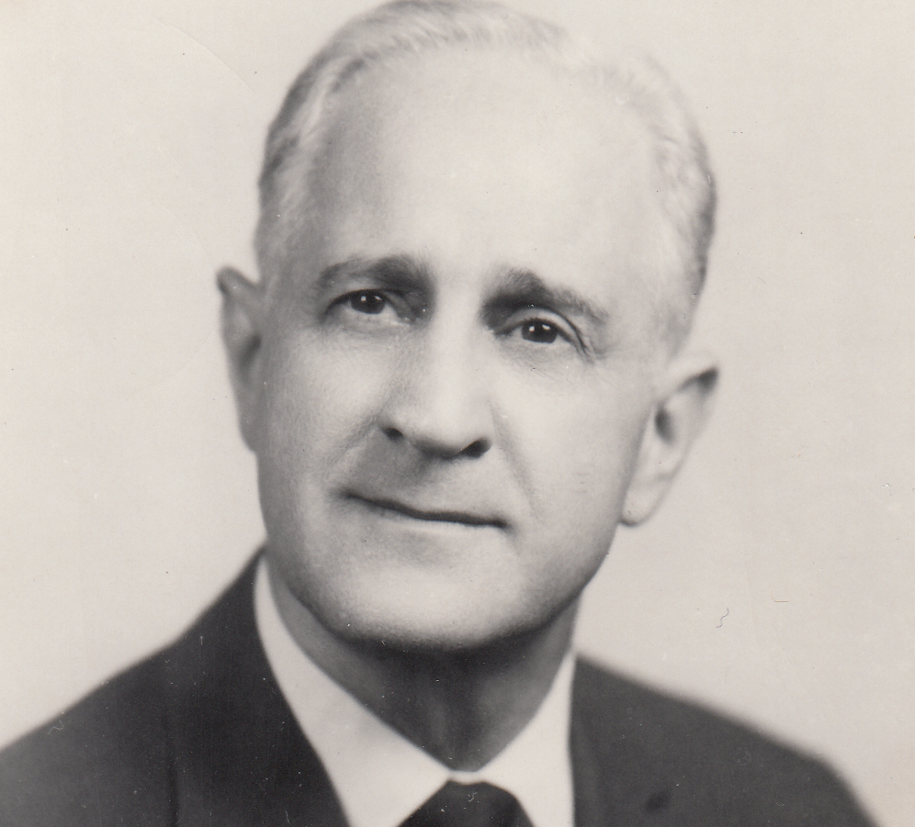
Dr. Leonard M. Monheim
University of Pittsburgh School of Dental Medicine
Began the dental anesthesiology and nurse anesthesia training programs
Classic texts on local and general anesthesia
“Sedalgesia”

Slide 25
What Do We Call This?
Intravenous analgesia
Intravenous anesthesia
Intravenous sedation
Chemanesia
Chemalgesia
Sedalgesia
Hypoesthesia
Hypoalgesia
Neuroleptanalgesia
Sedoamnesia
Lytic cocktail
Twilight sleep

Slide 26
Importance of Definitions
Dr. Monheim suggested the term “sedalgesia”
  Denoted a combination of sedation and local anesthesia
Distinction between sedalgesia and anesthesia
  Either the patients were conscious or they were not!
Altering the patient’s mood while maintaining consciousness and protective reflexes was Dr. Monheim’s vision for the future of sedation in dentistry

Slide 27
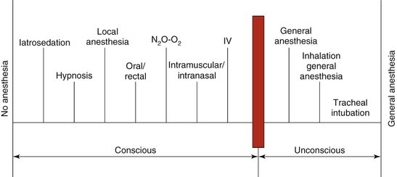
SPECTRUM OF PAIN CONTROL
Sedation continuum

Slide 28
Dr. C. Richard Bennett
Coined the term “conscious-sedation”
Classic text, Conscious Sedation in Dental Practice

Slide 29
Importance of Definitions and Terminology
Need for standardized descriptions of the changes that occur throughout the sedation continuum
Standard terminology is necessary for:
Who should do it
What training is required
What drugs should be used
What auxiliary personnel should be present
State permit requirements
Insurance reimbursement
Accreditation standards
Influence malpractice carrier standards
Conscious-sedation (Moderate Sedation) universally accepted terminology
Definite distinction between consciousness and unconsciousness
Alteration of mood while maintaining consciousness and protective reflexes
Need to Standardize Terminology

Slide 30
Development of the ADA Guidelines
Prior to first Guidelines there were no set educational requirements or practice parameters
Standardized training requirements
Standardized practice requirements
Dynamic document
Revised 10 times (most recently in 2016)
Guidelines are disseminated to state dental boards
Template for developing state anesthesia rules and regulations
Help fulfill mandate to protect the public
In some states a dental degree was sufficient to give general anesthesia
First Teaching and Use Guidelines established in 1971
Establish Training and Practice Guidelines

Slide 31
Development of the ADA Guidelines
Why make changes?
Improve safety and efficacy
Guidelines are scrutinized when morbidity and mortality occurs
Essential that Guidelines are current
Update education and best practices using evidence-based criteria
Reflect evolution of new medications and monitoring
Incorporate knowledge gleaned from analysis of adverse outcomes
Establish Training and Practice Guidelines

Slide 32
Development of the 2016 ADA Guidelines
ADA Council on Dental Education and Licensure (CDEL) responsible for Guideline revisions
Anesthesiology committee is a subcommittee of CDEL
Composed of representatives from anesthesia-specific societies
CDEL member, Chair
American Society of Anesthesiologists
American Dental Association
American Academy of Periodontologists
American Association of Oral and Maxillofacial Surgeons
American Academy of Pediatric Dentists
American Dental Society of Anesthesiology
American Society of Dentist Anesthesiologists
  CDEL’s Anesthesiology Committee

Slide 33
Development of the 2016 ADA Guidelines
Patient assessment
Increasing medical complexity
Oral dosing beyond the MRD
Dosing beyond the MRD is beyond minimal sedation
Route of administration vs. level of sedation
Patient is in an identical state regardless of route of administration
Training requirements should be the same
Capnography for moderate sedation
Early warning system for airway obstruction
Rationale for Revisions

Slide 34
Development of the 2016 ADA Guidelines
2016 Guidelines make no distinction between route of administration to achieve a set level of sedation
Previous Guidelines allowed for enteral moderate sedation and set separate training requirements
New Guidelines eliminate enteral moderate sedation terminology
Moderate sedation is defined
Practitioner must manage the patient at that level regardless of how they got there
Training must be equivalent
Level of Sedation Vs. Route of Administration

Slide 35
Development of the 2016 ADA Guidelines: Capnography
For moderate sedation, the dentist must monitor ventilation and/or breathing by monitoring end-tidal CO2 unless precluded or invalidated by the nature of the patient, procedure or equipment. In addition, ventilation should be monitored by continual observation of qualitative signs, including auscultation of breath sounds with a precordial or pretracheal stethoscope.

Slide 36
Impact of the Guidelines on Dental Practice
MINIMAL SEDATION
Inhalation sedation
14 hours
Clinical management
Demonstration of competency
Enteral sedation
16 hours
Clinical management
Demonstration of competency
Combination enteral/inhalational sedation
Completion of both courses
New Training Requirements
Notes:
Enteral sedation up to the MRD

Slide 37
Impact of the Guidelines on Dental Practice
MODERATE SEDATION
No distinction between enteral and parenteral sedation
60 hours of didactic instruction
20 individually managed cases
Competency in venipuncture
Competence in rescuing from deep level of sedation
New Training Requirements

Slide 38
Impact of the Guidelines on Dental Practice
2016 Guidelines address medical complexity
  Stresses evaluation of preoperative medical status
  Implementation of ASA physical status classification
  Consideration of airway assessment factors including BMI and obstructive sleep apnea
Increasing Medical Complexity

Slide 39
Preoperative Anesthetic Evaluation
Everybody Ought to Treat a Stranger Right
—Blind Willie Johnson
All Content © IMPA or used by permission

Slide 40
Overview
Components of a preanesthetic evaluation
Cardiovascular system considerations
Respiratory system considerations
Diabetes considerations
Neurological and developmental considerations
The preanesthetic evaluation identifies potentially reactive patients with the sole purpose of preventing, recognizing, and managing perioperative anesthetic urgencies and emergencies

Slide 41
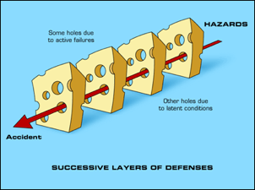
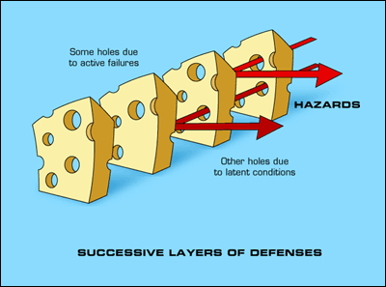
Components of a Preanesthetic Evaluation
Medical history questionnaire
Dialogue history
Physical examination
  Laboratory examination
Medical consultation

Slide 42
Past Medical History
Systems review
Medication history
Allergies
Previous surgical and anesthetic history
Family history
Social habits
Pregnancy

Slide 43
Medical History Questionnaire
Complete annually
Update on six-month intervals
  Changes in health status
  Current medical treatment
  Current medications

Slide 44
Dialogue History
Diabetes
Type?
How controlled?
Blood sugar levels?
A1C?
Hospitalization?

Slide 45
Medications
Medical status
Purpose for taking the drug
Recent prescription changes
Compliance
OTC, herbal products
Drug classification
Prescribed dose and schedule
Side effects and adverse reactions
Precautions w/dental care
Drug interactions
Treatment modifications indicated

Slide 46
Addictive Habits
Cigarette smoking
  Cardiovascular, pulmonary systems
  Hemostasis
Alcohol
Cocaine
Psychotropic/illegal drugs

Slide 47
Quantifying Anxiety and Fear: MDAS
If you went o your dentist for TREATMENT TOMORROW, how would you feel?
  Not anxious
  Slightly anxious
  Fairly anxious
  Very anxious
  Extremely anxious

Slide 48
Quantifying Anxiety and Fear: MDAS
If you were sitting in the WAITING ROOM (waiting for treatment), how would you feel?
  Not anxious
  Slightly anxious
  Fairly anxious
  Very anxious
  Extremely anxious

Slide 49
Quantifying Anxiety and Fear: MDAS
If you were about to have a TOOTH DRILLED, how would you feel?
  Not anxious
  Slightly anxious
  Fairly anxious
  Very anxious
  Extremely anxious

Slide 50
Quantifying Anxiety and Fear: MDAS
If you were about to have your TEETH SCALED AND POLISHED, how would you feel?
  Not anxious
  Slightly anxious
  Fairly anxious
  Very anxious
  Extremely anxious

Slide 51
Quantifying Anxiety and Fear: MDAS
If you were about to have a LOCAL ANESTHETIC INJECTION in your gum, above an upper back tooth, how would you feel?
  Not anxious
  Slightly anxious
  Fairly anxious
  Very anxious
  Extremely anxious

Slide 52
Quantifying Anxiety and Fear: MDAS
Not anxious
  1
Slightly anxious
  2
Fairly anxious
  3
Very anxious
  4
Extremely anxious
  5
Total score
  Range 5-25

Slide 53
Physical Exam
Visual inspection
Exercise tolerance
Heart and lungs
Range of motion
Nasal patency
Dentition
Tongue and neck size
Vital signs

Slide 54
Classification of Hypertension
CLASSIFICATION† | BLOOD PRESSURE (MM HG)
 | SYSTOLIC | DIASTOLIC
Normal | 119 or lower | 79 or lower
Prehypertension | 120 to 139 | 80 to 89
Stage 1 hypertension | 140 to 159 | 90 to 99
Stage 2 hypertension | 160 or higher | 100 or higher

Slide 55
Medical Consultation
Purpose of pretreatment evaluation is to assess the patient’s current medical status, not to give medical clearance
  Treatment to be rendered
  Review of medical history
  Request assessment of medical condition
A physician can neither grant nor deny you the right to treat your patient in the manner you deem necessary
Direct the consultant to address specific questions and issues
  Stress test needed - delay treatment?
  Anticoagulation - modify regimen?
  Asthma management – pretreatment?

Slide 56
Conditions Requiring Medical Consultation
Unstable coronary syndromes (i.e. unstable angina)
Severe heart failure (i.e. ankle edema, ascites, shortness of breath)
Significant arrhythmias (i.e. atrial fibrillation, heart block)
Severe valvular disease (i.e. audible murmur, decompensation with exertion)
MI, bypass surgery, cardiac stenting within the past 6 months
Stroke within the past 6 months
Blood pressure > 160/100
Pacemaker and/or implantable cardioverter/defibrillator
History of prior subacute bacterial endocarditis
Inability to walk up a flight of stairs with a bag of groceries (i.e. < 4 METS)
Cardiovascular

Slide 57
Conditions Requiring Medical Consultation
Significant COPD (i.e. chronic shortness of breath)
Poorly controlled asthma (i.e. active wheezing or frequent use of rescue inhaler)
Hemoptysis
Uncontrolled or frequent seizures
Respiratory
CNS

Slide 58
Conditions Requiring Medical Consultation
Uncontrolled diabetes (i.e. blood glucose > 400, HbA1c > 10.5, history of hospitalizations or diabetic ketoacidosis)
Clinically evident hyperthyroidism
Pituitary disorders
Adrenal suppression/insufficiency (i.e. Addison’s disease)
Morbid obesity (i.e. BMI >40)
Cirrhosis
Jaundice
Metabolic/Endocrine
Hepatic

Slide 59
Conditions Requiring Medical Consultation
Renal failure
Dialysis
History of organ transplant
Bleeding within the past 6 months
Renal
GI
Transplants

Slide 60
Conditions Requiring Medical Consultation
Hepatitis C
TB
HIV/AIDS
Local anesthetics
Bleeding disorders
Sickle cell disease
Thrombocytopenia
INR > 3.0
Symptomatic Infectious Diseases
Allergy
Hematology

Slide 61
Contraindications to Dental Treatment
Acute or recent MI
Unstable or recent-onset angina
Serious CHF
Uncontrolled hypertension
Uncontrolled dysrhythmia
Uncontrolled diabetes
Uncontrolled hyperthyroidism

Slide 62
Assignment of Risk
ASA Class I
Healthy patient who is free of organic disease.
ASA Class II
Patient with mild systemic disease that does not limit activity
ASA Class III
Patient with severe systemic disease that limits activity, but is not incapacitating
ASA Risk Classification
ASA Class IV
Patient with an incapacitating systemic disease that is a constant threat to life
ASA Class V
Moribund patient not expected to survive 24 hours with or without surgery
ASA Class VI
Organ donor

Slide 63
Preanesthetic Evaluation Note
Age/Sex: 58 y.o. ♂ for full mouth extraction
Past Medical History:Review of Systems
Past Surgical and Anesthetic History:
Past Family History:
Allergies:
Medications:
Physical Exam:
  Vital Signs
  Height
  Weight
  BMI
  Range of Motion
  Dentition
  Mallampati classification
  Heart
  Lungs
  Labs
  ASA classification
Plan: GA, IV sedation, etc. Discussed anesthesia plan, risks explained, understood and accepted by patient (parent, guardian)

Slide 64
Cardiovascular System
Coronary artery disease
Hypertension
Infarction
Valve disease
Dysrhythmia
Heart failure

Slide 65
Cardiovascular Stress Response
Catecholamine release
Increased cardiac output
Increased myocardial oxygen demand
Myocardial ischemia
Acute congestive heart failure
Cardiac dysrhythmias

Slide 66
Cardiac Risk Index
Evaluation
Points
History
  Age > 70
  MI within 6 months
Physical
  3rd heart sound/JVD
  Aortic stenosis
EKG
  Rhythm other than sinus or PAC
  > 5 PVC’s / min
5
10
11
3
7
7

Slide 67
Cardiac Risk Index
Evaluation
Points
Poor general medical condition
Surgical site
  Intraperitoneal, aortic, intrathoracic
Emergency
3
3
4

Slide 68
Cardiac Risk Index
Points
NYHA Classification
Unstable angina
Class III
Class IV
10
10
20

Slide 69
Point Score vs. Risk
Points | Complications | Mortality
0-5 | 0.7% | 0.2%
6-12 | 5% | 2%
13-24 | 11% | 2%
25 | 22% | 56%

Slide 70
Metabolic Equivalent (MET)
1 MET = 3.5 cc O2/kg/min
Measure of exercise tolerance
  Functional capacity
Perioperative cardiac risk is increased in patients unable to meet a 4-MET demand during most daily activities

Slide 71
Cardiac Functional Capacity
Metabolic Equivalencies (METS)
1 - 4
  Eating, dressing, walking about home, moderate housework
4 - 10
  Stairs, walking briskly, light yard work, golf
>10
  Strenuous sports

Slide 72
Questions to Ask With a Positive Cardiovascular History
Chest pain?
Shortness of breath?
Dyspnea on exertion?
Paroxysmal nocturnal dyspnea?
  Wakes up at night with shortness of breath
Orthopnea?
  Needs extra pillows to improve breathing
Recent hospitalization?
Functional capacity?
  MET level?
  Change in exercise tolerance?
If patient can perform at ≥ 4 METS and answers NO to these questions: Treatment may proceed

Slide 73
CV Treatment Considerations
Moderate sedation
  Patient remains conscious
Scheduling
Chair position
Local anesthetics
  Smart injection
  Vasoconstrictors
  Beta blockers

Slide 74

Respiratory Disease
Asthma
Chronic bronchitis
Emphysema
Obstructive sleep apnea

Slide 75
Asthma
Airway inflammation
Airflow obstruction
Intermittent symptoms
  Wheezing
  Chest tightness
  Dyspnea
  Cough
Considerable variation in severity within and between individuals
3-5% of US population

Slide 76
Chronic Bronchitis
Clinical history of a productive cough
  3 months out of the year
  2 consecutive years
Cigarette smoking is primary cause
  90%
Inflammation of the airways
  Mucosal thickening
  Mucus hypersecretion
  Diffuse obstruction with ventilation/perfusion mismatching
    Hypoxemia

Slide 77
Emphysema
Abnormal permanent enlargement of the respiratory unit accompanied by destruction of the alveolar wall
Loss of elastic tissue
  Nonreversible
  Loss of recoil support during expiration
  Premature expiratory collapse (air-trapping)
  Increased lung compliance
Loss of alveolar surface area
  Hypoxemia
Loss of alveolar capillaries

Slide 78
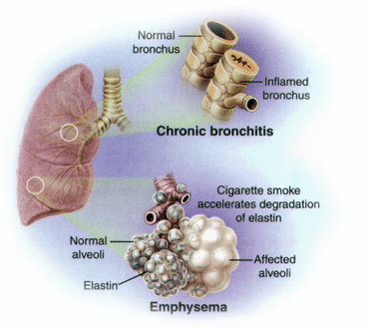
Obstructive Lung Disease

Slide 79
COPD
Approximately 24 million cases nationwide
Third leading cause of death worldwide by 2020
Incidence increases with age
Smoking is primary cause
Chronic inflammation and oxidative stress
Fibrosis, coalescence of alveoli, narrowing of small airways
Hypoxic pulmonary vasoconstriction and pulmonary hypertension

Slide 80
Preoperative Assessment for COPD
Identify risk factors
Smoking, aging, poor exercise tolerance
Evaluate severity
Positive cough test
Deep breath and cough (followed by another cough)
> 40 pack-year history of smoking
Significantly impaired PFT’s
Medical optimization
EKG
Echocardiogram
Room air SpO₂ ≥ 92%
Smoking cessation

Slide 81
Global Initiative for Chronic Obstructive Lung Disease (GOLD)
Measures respiratory impairment after bronchodilator treatment
GOLD 1 (Mild)
FEV₁ ≥ 80%
GOLD 2 (Moderate)
FEV₁ 50%-80%
GOLD 3 (Severe)
FEV₁ 30%-50%
GOLD 4 (Very Severe)
FEV₁ < 30%

Slide 82
Anesthetic Considerations in COPD
GOLD 1 and 2 patients in office
Minimal or moderate sedation
Supplemental oxygen
GOLD 3 and 4 patients
Local anesthesia alone
Hospital

Slide 83
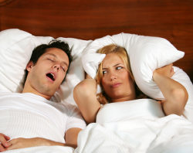
Obstructive Sleep Apnea
The New Normal

Slide 84
Obesity and Obstructive Sleep Apnea
Up to 90% of adult patients with OSA are obese
OSA parallels the obesity epidemic
Cessation of airflow for more than 10 seconds despite continuing ventilatory effort, 5 or more times per hour of sleep and a decrease of more than 4% in SpO2
Sleepiness, nonrestorative sleep, fatigue, or insomnia symptoms
Waking up with breath holding, gasping, or choking
Habitual snoring, breathing interruptions, or both noted by a bed partner or other observer

Slide 85
The New Normal
Among middle-aged adults –
4% of men & 2% of women
Estimated that 80-95% are undiagnosed
Testing increasing 124% every 3 years
Diagnosis of OSA will increase 5 to 10-fold over next decade

Slide 86
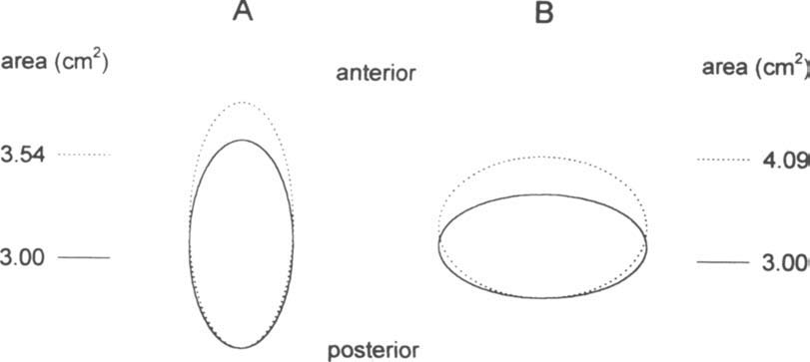
Notes:
Fat deposition changes geometric form

Slide 87


Slide 88
STOP BANG
(Screening for OSA)
S (snore)
Have you been told that you snore?
T (tired)
Are you often tired during the day?
O (obstruction)
Do you know if you stop breathing or has anyone witnessed you stop breathing while you are asleep?
P (pressure)
Do you have high blood pressure or on medication to control high blood pressure?

Slide 89
STOP BANG
(Screening for OSA)
B (BMI)
Is your body mass index greater than 35?
A (age)
Are you 50 years old or older?
N (neck)
Are you a male with a neck circumference greater than 17 inches, or a female with a neck circumference greater than 16 inches?
G (gender)
Are you a male?

Slide 90
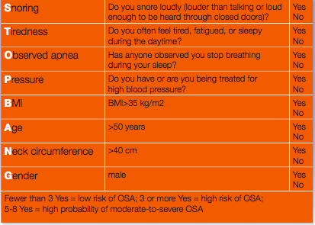

Slide 91
OSA Comorbidities
Hypertension
Refractory hypertension is associated with OSA in 83% of patients
Stroke
Chronic intermittent hypoxia is a key factor in vascular inflammation, atherosclerosis, and endothelial disease
Rise in sympathetic activity and blood pressure amplify the effect of inflammation
Atrial fibrillation
Increased state of thrombosis, inflammation, and oxidative stress is pro-arrhythmogenic
Dementia

Slide 92
OSA Comorbidities
Pulmonary hypertension
15 – 70%
Heart failure
OSA is the most common co-morbidity
70%
Coronary artery disease
20– 25%
Major cardiac events more likely

Slide 93
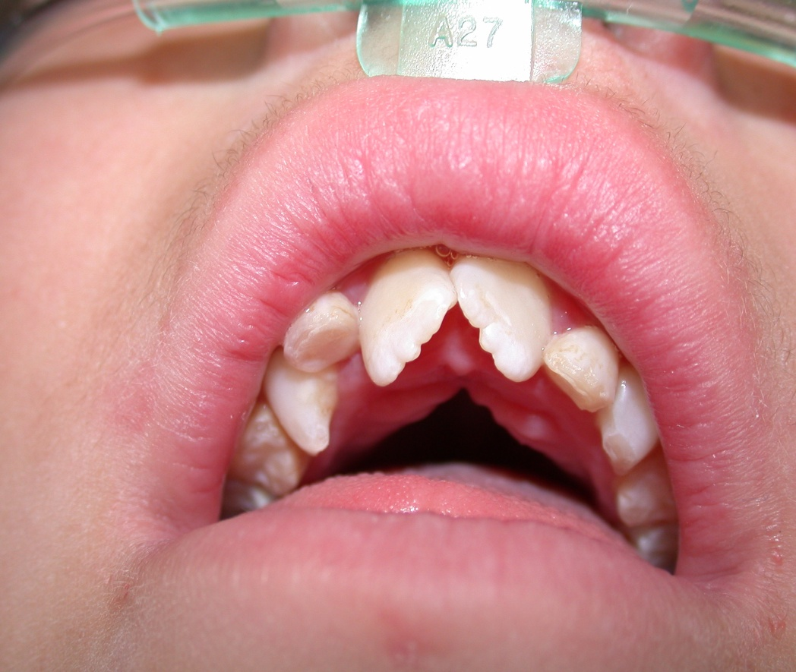
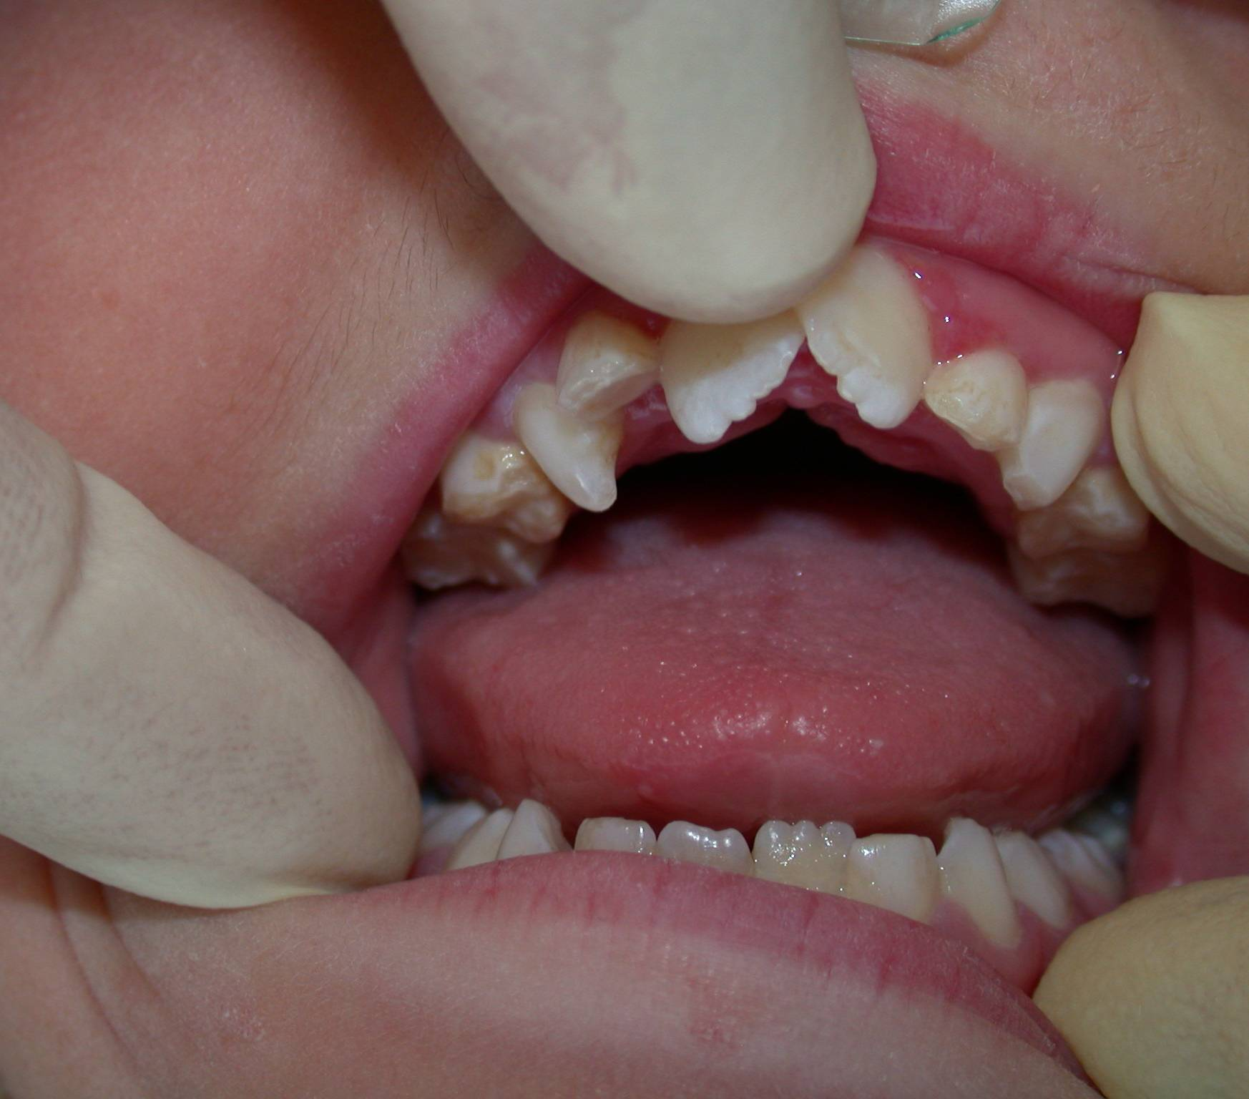

Slide 94
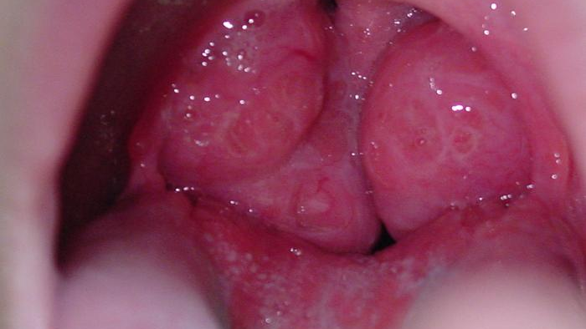

Slide 95
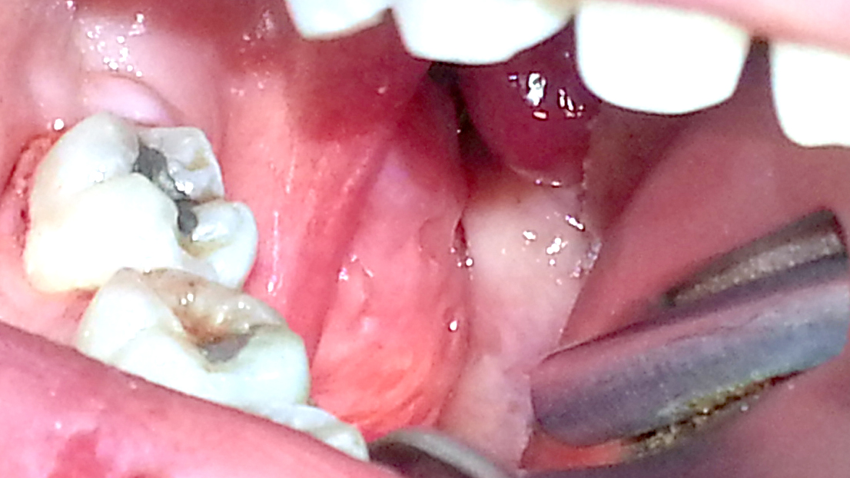

Slide 96
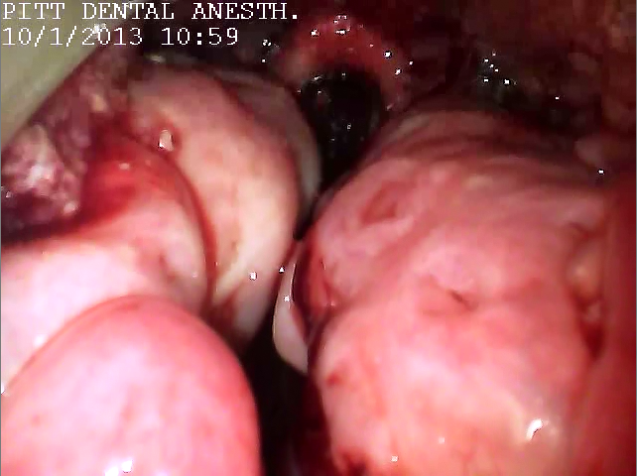

Slide 97
Respiratory Treatment Considerations
Moderate sedation
  Patient remains conscious
Afternoon appointments
Pretreatment bronchodilation
Consider CPAP for OSA

Slide 98
Diabetes Mellitus
Type I
B-cell destruction
Insulin deficiency
Autoimmune process
10% of cases
Type II
Insulin resistance
Relative insulin deficiency
10x more common than Type I
80% of cases associated with obesity

Slide 99
Risk Factors For Type 2 Diabetes
Age > 45 years
Overweight or obese
Parent, brother, or sister with diabetes
African American, American Indian, Asian American, Pacific Islander, or Hispanic American/Latino
Gestational diabetes, or birth to at least one baby weighing more than 9 pounds
Blood pressure 140/90 or higher
High cholesterol
Inactivity, exercise fewer than three times a week

Slide 100
Fasting Plasma Glucose
Normal
  ≤99 mg/dl
Pre-diabetes
  100 to 125 mg/dl
Diabetes
  ≥126 mg/dl

Slide 101
Comorbidities of Diabetes
Microvascular disease
Retinopathy
Nephropathy
Macrovascular disease
Coronary artery disease
Cerebrovascular disease
Peripheral vascular disease
Neuropathic disease
Foot ulcers
Infections

Slide 102
Comorbidities of Diabetes
Heart disease and stroke
Accounts for about 65% of deaths
Heart disease death rate 2 to 4 times higher than without diabetes
Risk for stroke is 2 to 4 times higher among people with diabetes
High blood pressure
About 73% of adults with diabetes have hypertension or use prescription medications for hypertension
Blindness
Leading cause of new cases of blindness among adults aged 20-74 years
Diabetic retinopathy causes 12,000 to 24,000 new cases of blindness each year

Slide 103
Comorbidities of Diabetes
Kidney disease
Diabetes is the leading cause of kidney failure
44% of new cases in 2002
Nervous system disease
60% to 70% of diabetics have mild to severe forms of nervous system damage
Almost 30% aged 40 years or older have impaired sensation in the feet
Amputations
More than 60% of non-traumatic lower-limb amputations occur in people with diabetes

Slide 104
Preventing Diabetes Complications
Glucose control
Every percentage point drop in A1C blood test results (e.g., from 8% to 7%) reduces the risk of microvascular complications (eye, kidney, and nerve diseases) by 40%
Blood pressure control
33% to 50% reduced risk of cardiovascular disease
Risk of microvascular complications by approximately 33%

Slide 105
Preventing Diabetes Complications
Control of blood lipids
Control of cholesterol or blood lipids can reduce cardiovascular complications by 20% to 50%
Preventive care practices for eyes, kidneys, and feet
Reduce severe vision loss by 50% to 60%
Reduce amputation rates by 45% to 85%
Lowering blood pressure can reduce the decline in kidney function by 30% to 70%
Treatment with ACE inhibitors and angiotensin receptor blockers (ARBs) are more effective in reducing the decline in kidney function than other blood pressure lowering drugs

Slide 106
Hemoglobin A1C
Glycated hemoglobin or glycosylated hemoglobin
Indicates a patient's blood sugar control over the last 2-3 months
A1C formed when glucose in the blood binds irreversibly to hemoglobin to form a stable glycated hemoglobin complex
Normal life span of red blood cells is 90-120 days
A1C will only be eliminated when the red cells are replaced
A1C values proportional to the concentration of glucose in the blood over the full life span of the red blood

Slide 107
Hemoglobin A1C
Hb A1C | Mean Blood Glucose (mg/dl) | Interpretation
4 | 61 | Non-
5 | 100 | Diabetic
6 | 124 | Range
7 | 156 | Target for Control
8 | 188
9 | 219 | Action
10 | 251 | Suggested
11 | 283
12 | 314

Slide 108
Treatment Considerations for the Diabetic Patient
Morning appointments
Stress reduction protocol
Blood glucose < 250 ml/dl
  Maintain meal/insulin schedule
If NPO
  Reduce basal insulin by half
  Skip fast acting insulin dose

Slide 109
Neurological Disorders
Spinal muscular atrophy
ALS
Muscular dystrophy
Parkinson’s disease
Myasthenia gravis
Cerebral palsy
Alzheimer’s disease/dementia
Down syndrome

Slide 110
Patients With Neurological Disorders Are Susceptible To:
Airway obstruction
Respiratory depression
Hypoxia
Aspiration
Pneumonia
GERD
Cardiovascular comorbidities
OSA
If sedation is required, consideration should be given to hospitalization or use of a dedicated anesthesia specialist

Slide 111

Problems Related to Aging
Considerations for the Elderly

Slide 112
Overview
Syndromes of aging
Problems specific to aging
Obesity
Obstructive sleep apnea
Diabetes
Atrial fibrillation
Cognitive impairment
Geriatric pharmacology
Anesthetic considerations
COPD
Parkinson’s disease

Slide 113
Graying Of America
More than 55 million people over the age of 65 in the United States
In 2011, the first members of the “boomer” generation reached age 65
By 2030, 70 million over the age of 65
One in five Americans
By 2050, life expectancy projected to increase to 82.6 years

Slide 114
Categories of Aging
Young old
65-74
Middle old
75-84
Old old
85-100
Elite old
> 100

Slide 116
Polypharmacy of Aging
25 % of people ages 65 to 69 take at least five prescription drugs to treat chronic conditions
46% for those between 70 and 79
It is not uncommon to encounter patients taking more than 20 drugs

Slide 117
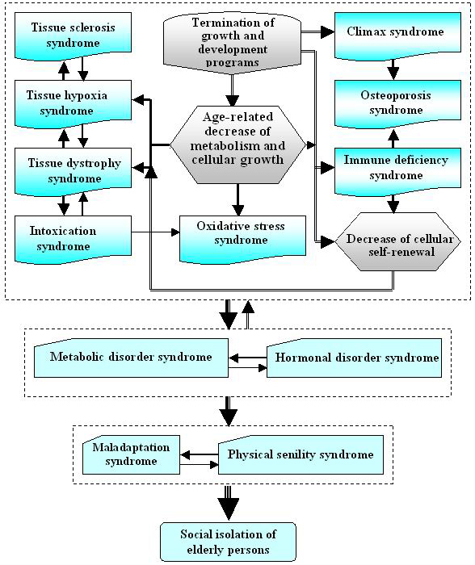

Slide 118
Syndromes of Aging
Tissue dystrophy syndrome
Reduction of metabolism
Termination of growth and development
Reduction of cellular renewal
Tissue sclerosis syndrome
Connective tissue proliferation
Vascular sclerosis and hemodynamic disorders
Tissue hypoxia syndrome
Depletion of capillary network
Hemodynamic instability
Alveolar gas disturbances
Krutko VN, Dontsov VI, Khalyavkin AV, Markova AM. Natural aging as as a sequential poly-systemic syndrome. Frontiers in Bioscience. 2018;23:909-20.

Slide 119
Syndromes of Aging
Intoxication syndrome
Environmental and endogenous intoxication
Oxidative stress syndrome
Free radicals
Chronic stress
Immune deficiency syndrome
Reduction in T-lymphocytes
Increase in immune complexes and autoantibodies
Krutko VN, Dontsov VI, Khalyavkin AV, Markova AM. Natural aging as as a sequential poly-systemic syndrome. Frontiers in Bioscience. 2018;23:909-20.

Slide 120
Syndromes of Aging
Maladaptation syndrome
Psychological and emotional stress
Blood content changes
Decline in viability
Physical senility syndrome
Decreased cardiovascular function
Malnutrition
Muscle wasting
Osteoporosis
Metabolic disorder syndrome
Changes in lipid, carbohydrate, water/salt metabolism
Obesity, atherosclerosis, ischemic heart disease
Krutko VN, Dontsov VI, Khalyavkin AV, Markova AM. Natural aging as as a sequential poly-systemic syndrome. Frontiers in Bioscience. 2018;23:909-20.

Slide 121
Syndromes of Aging
Hormonal disorder syndrome
Thyroid dysfunction
Sexual dysfunction
Termination of growth processes
Social isolation and neurocognitive dysfunction
Retirement
Loss of peer group
Cognitive impairment
Sleep disorders
Krutko VN, Dontsov VI, Khalyavkin AV, Markova AM. Natural aging as as a sequential poly-systemic syndrome. Frontiers in Bioscience. 2018;23:909-20.

Slide 122
Problems Specific to Aging

Slide 123
Obesity
Global population of individuals aged 60 years and older is expected to nearly double from 12 to 22% between 2015 and 2050
Obesity exacerbates aging-associated inflammation by impairing insulin responsiveness
Redistribution of adipose tissue to the abdominal compartment associated with increased risk of chronic disease
Buffering of dietary lipids declines with age
Low-grade state of inflammation
Insulin resistance
Metabolic syndrome
Notes:
Lipids are deposited in the liver and skeletal muscle.

Slide 124
“Inflammaging”
Chronic low-grade inflammation in the absence of infection
Inflammatory state increases risk of cardiovascular disease, type 2 diabetes, arthritis, among others
Disrupt insulin receptor signaling cascades and promote insulin resistance
Decline in autonomic nervous system function
Enhanced activity results in NE reduction
Increase in adipose tissue
Insulin resistance
Endocrine dysfunction

Slide 125
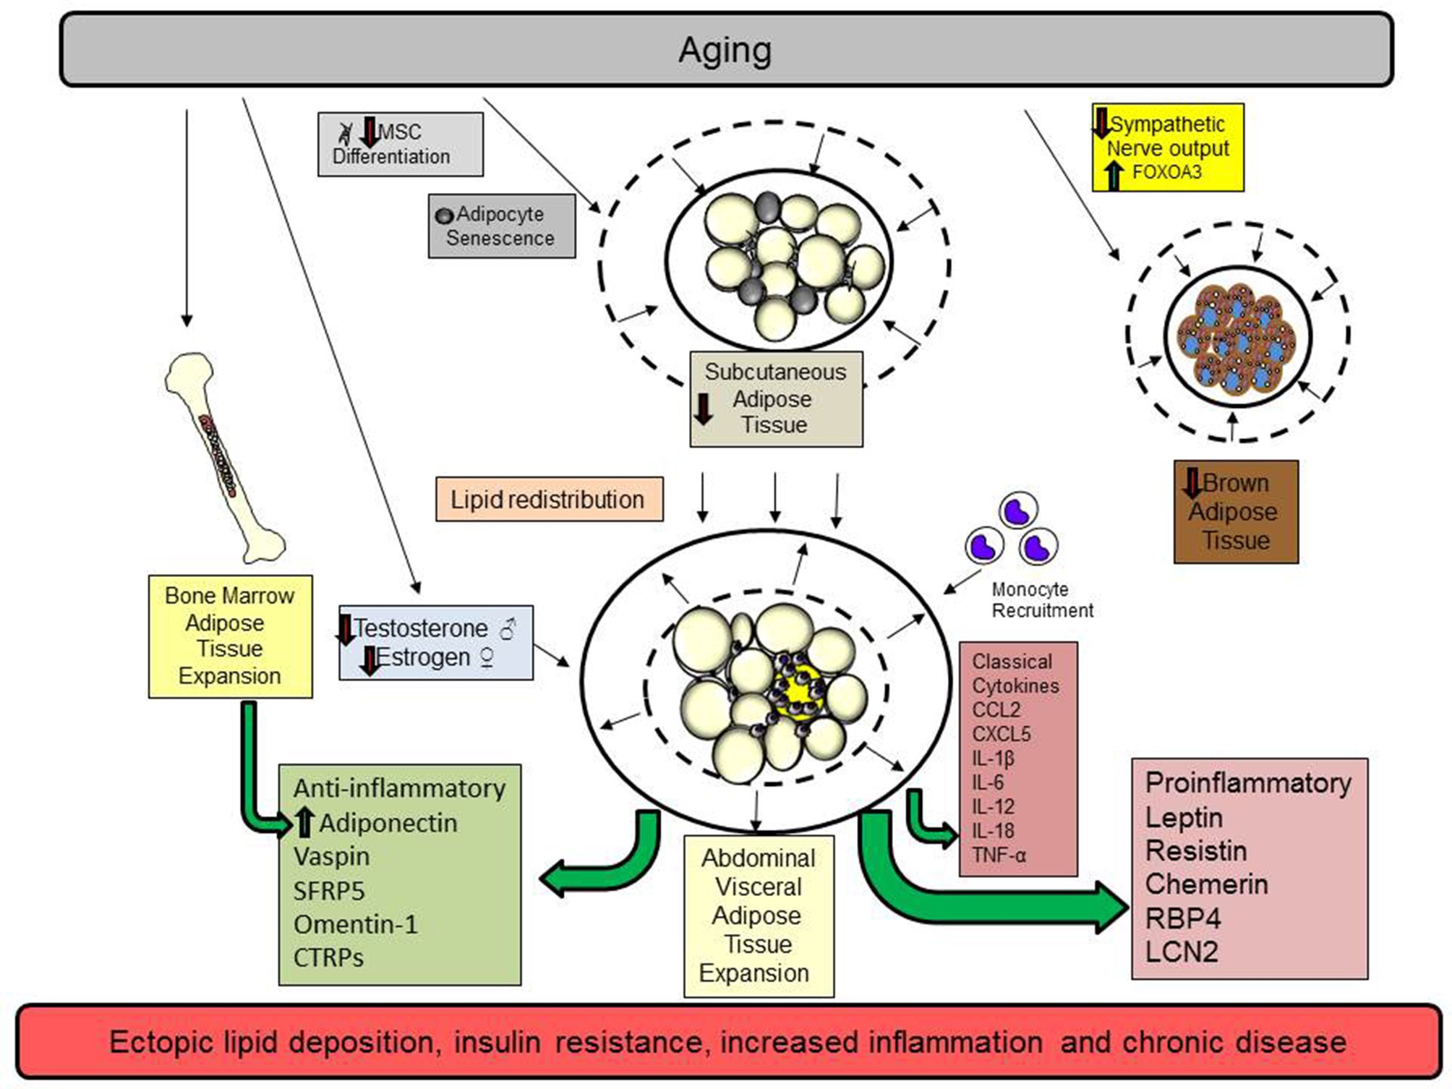
Notes:
Proinflammatory adipokines result in decreased energy, insulin resistance, diabetes, cardiovascular disease

Slide 126
Summary
Age-related lipid redistribution and obesity promotes a chronic inflammatory state
Appetite suppression
Decreased energy
Muscle wasting
Insulin resistance
Type II diabetes
Cardiovascular disease

Slide 127
Problems Specific to Aging
Up to 90% of adult patients with OSA are obese
Obesity becomes more prevalent with age
Comorbidities exacerbated by age
Hypertension
Mood disorder
Cognitive dysfunction
Coronary artery disease
Stroke
Congestive heart failure
Atrial fibrillation
Type 2 diabetes
Obstructive Sleep Apnea

Slide 128
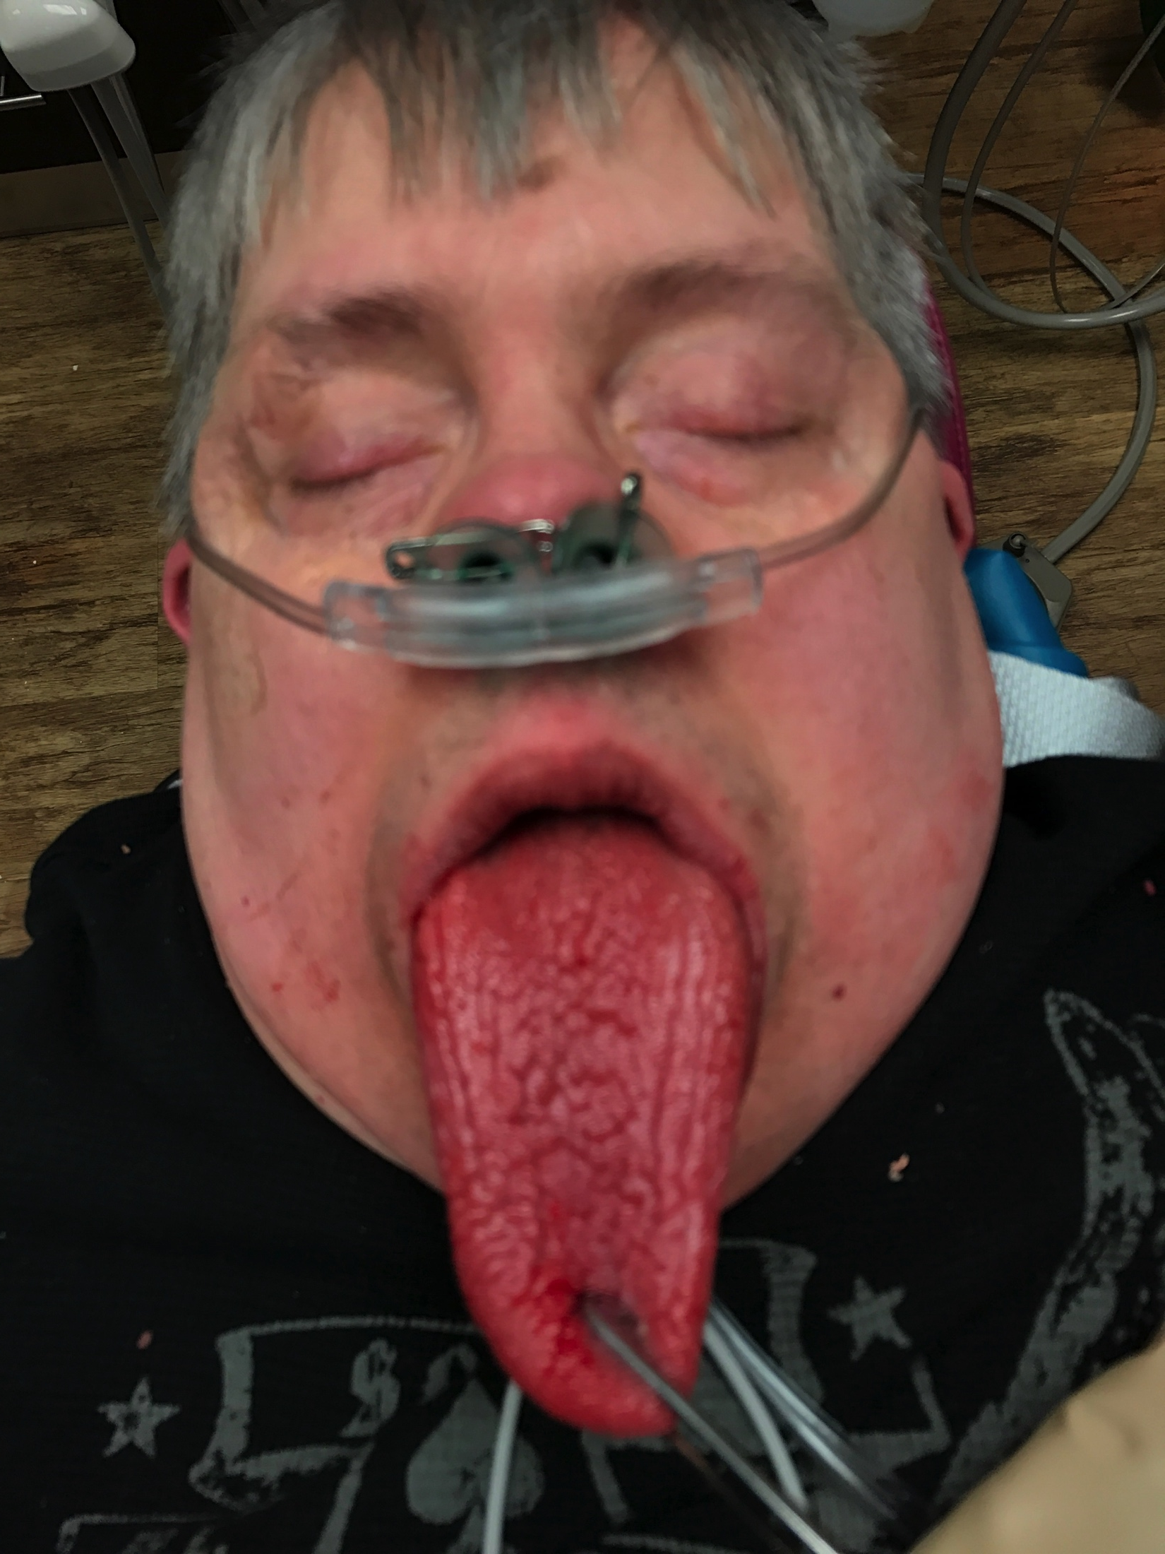
Obesity Adversely Impacts Airway Anatomy
Inverse relationship between obesity and pharyngeal area
Fat deposits in uvula, tongue, tonsillar pillars, aryepiglottic folds and lateral pharyngeal walls
Decrease in normal muscle function
Susceptible to airway collapse
Risk of OSA increases with neck obesity vs. general obesity

Slide 129
Increased Upper Airway Length (UAL)
Increased length in men, increased with age
Increased pharyngeal length predisposes to airway to collapse during inspiration (negative pressure)
UAL is directly proportional to AHI-OSA severity

Slide 130
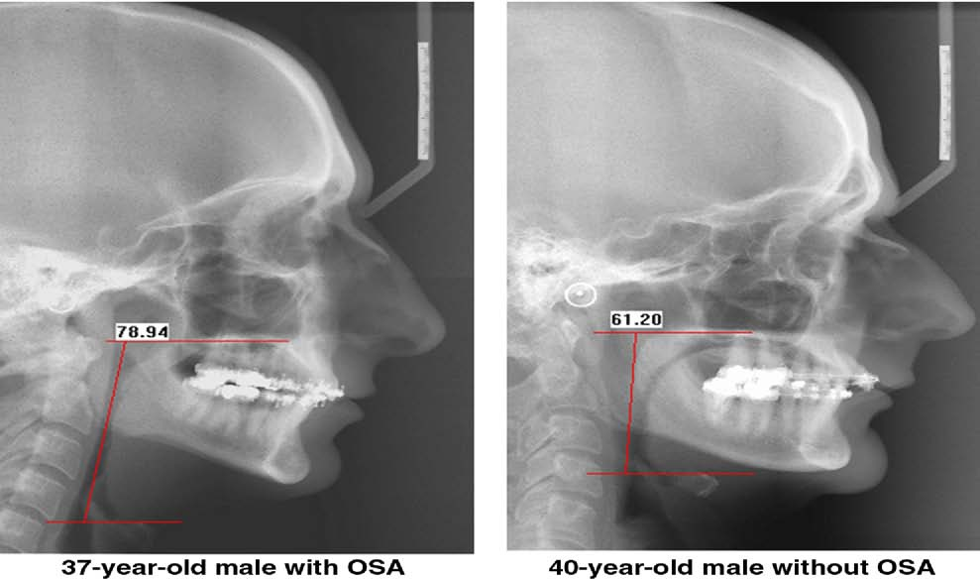
Increased UAL: “Lowering of the Hyoid”
OSA

Slide 131
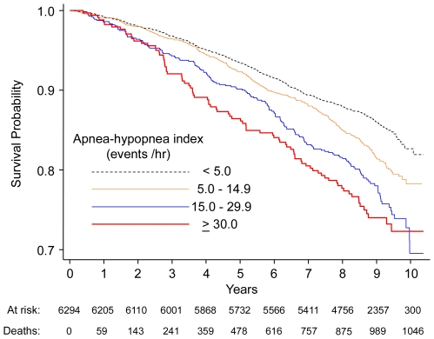

Slide 132
COPD
Approximately 24 million cases nationwide
Third leading cause of death worldwide by 2020
Incidence increases with age
Smoking is primary cause
Chronic inflammation and oxidative stress
Fibrosis, coalescence of alveoli, narrowing of small airways
Hypoxic pulmonary vasoconstriction and pulmonary hypertension

Slide 133
Preoperative Assessment for COPD
Identify risk factors
Smoking, aging, poor exercise tolerance
Evaluate severity
Positive cough test
Deep breath and cough (followed by another cough)
> 40 pack-year history of smoking
Significantly impaired PFT’s
Medical optimization
EKG
Echocardiogram
Room air SpO₂ ≥ 92%
Smoking cessation

Slide 134
Global Initiative for Chronic Obstructive Lung Disease (GOLD)
Measures respiratory impairment after bronchodilator treatment
GOLD 1 (Mild)
FEV₁ ≥ 80%
GOLD 2 (Moderate)
FEV₁ 50%-80%
GOLD 3 (Severe)
FEV₁ 30%-50%
GOLD 4 (Very Severe)
FEV₁ < 30%

Slide 135
Anesthetic Considerations in COPD
GOLD 1 and 2 patients in office
Minimal or moderate sedation
Low dose midazolam
Low dose remifentanil
Dexmedetomidine
Supplemental oxygen
Maintain SpO₂ 88%-92%
Avoids hypoxemia and hypercarbia
GOLD 3 and 4 patients
Local anesthesia alone
Hospital

Slide 136
Alzheimer’s Disease
Neurodegenerative disease that typically affects older populations and is the leading cause of dementia worldwide
Prevalence is projected to triple by 2050
Cost of care for dementia is expected to increase from $818 billion in 2015 to $2 trillion by 2030
Characterized by the accumulation of Aβ and neurofibrillary tangles composed of hyperphosphorylated tau (P-tau)
Neuronal loss

Slide 137
Alzheimer’s Disease
Modifiable risk factors associated with 1/3 of cases
  Hypertension
  High cholesterol
  Obesity
  Poor diet
  Inactivity
  Diabetes

Slide 138
Type II Diabetes:
Insulin Resistance and Cognitive Function
Nearly 30.3 million Americans have diabetes and another 84.1 million have prediabetes
Insulin resistance is associated with:
Accelerated cognitive decline
Cerebral atrophy
Altered cerebral blood flow and metabolism
Insulin signaling serves a neuromodulatory role within the CNS
Evidence of cerebral insulin resistance in both aging and Alzheimer’s Disease
Experimentally increasing circulating insulin levels appears to benefit cognition
Williams VJ, Trombetta BA, Jafri RZ, et al. Task-Related fMRI BOLD Response to Hyperinsulinemia in Healthy Older Adults, JCI Insight, 2019, https://doi.org/10.1172/jci.insight.129700.

Slide 139
Atrial Fibrillation
~1 in 4 people will develop A-Fib at some point in their life
As the patient ages, the risk of thrombus formation in the atria with subsequent stroke/PE increases
Age 50-59: 1.5% risk
Age 80-89: 23.5% risk
Without anticoagulation prophylaxis, the 30-day mortality of AF related stroke is ~24%

Slide 140
CHA₂DS₂-VASC
 | Condition | Points
C | Congestive Heart Failure | 1
H | Hypertension | 1
A2 | Age > or = to 75 years | 2
D | Diabetes Mellitus | 1
S2 | Prior Stroke, TIA, or Thromboembolism | 2
V | Vascular Disease (Peripheral Artery Disease, MI, Aortic Plaque) | 1
A | Age 65-74 | 1
Sc | Sex Category (Female) | 1

Slide 141
CHA₂DS₂-VASC (Risk of Stroke)
Score | Stroke Risk %
0 | 0
1 | 2.0
2 | 3.7
3 | 5.9
4 | 9.3
5 | 15.3
6 | 19.7
7 | 21.5
8 | 22.4
9 | 23.6

Slide 142
A-Fib and Dementia
6030 patients with no dementia and chronically anticoagulated
  Later followed for dementia incidence
AF cohort
  69.3 ± 11.2 years, 52.7% male
Non-AF cohort
  69.3 ± 10.9 years, 51.5% male
Dementia risk increased with increasing CHADS2 scores
AF was associated with higher rates of dementia across all CHADS2 scores
Graves KG, May HT, Jacobs V, et al. Atrial fibrillation incrementally increases dementia risk across all CHADS₂ and CHA₂DS₂VASc strata in patients receiving long-term warfarin. American Heart Journal, 2017;188:93-98.

Slide 143
A-Fib and Dementia

Slide 144
Parkinson's Disease
Estimated 1 million in US
  Number expected to double in next 30 years
Dopaminergic neurons
  Modulate the balance between ACh and GABA
  Dopamine inhibits GABA output
  ACh stimulates GABA output
Selective degeneration of dopaminergic neurons in Parkinson’s disease
Increased GABA output produces akinesia and bradykinesia

Slide 145
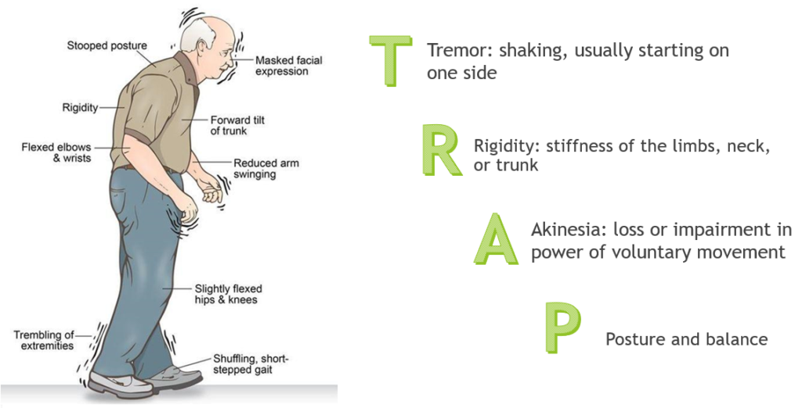
Parkinson’s Disease

Slide 146
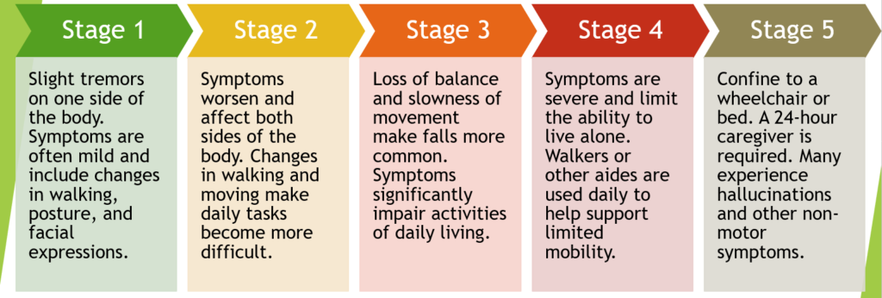
Stages of Parkinson’s Disease

Slide 147
Treatment of Parkinson’s Disease
Anticholinergic drugs
  Benztropine
Cholinesterase inhibitors
  Rivastigmine
  Donepezil
  Galantamine
COMT inhibitors
  Entacapone
  Tolcapone
  Opicapone
  Nitecapone
Dopaminergic drugs
  Levodopa
  Bromocriptine
  Pergolide
  Amantadine
MAOI-B
  Selegiline
  Rasagiline

Slide 148
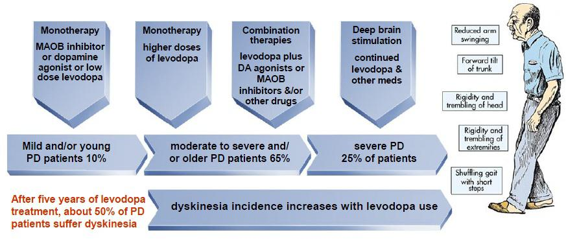
Treatment of Parkinson’s Disease

Slide 149
Anesthetic Considerations
Levodopa therapy results in systemic cardiovascular system effects
  Levodopa may result in depletion of norepinephrine stores in the autonomic nervous system
  Depletion of norepinephrine may sensitize adrenergic receptors to the effects of exogenously administered catecholamines such as epinephrine administered with local anesthetics

Slide 150
Anesthetic Considerations
The renin-angiotension system is also inhibited by low concentrations of dopamine
May result in reduced intravascular fluid volume and make patients susceptible to intraoperative and/or orthostatic hypotension
Levodopa may induce PONV

Slide 151
Geriatric Pharmacology
Pharmacodynamic and kinetic changes
Drug interactions with polypharmacy
Neurologic changes
More hypotension and hemodynamic instability
Lower anesthetic requirements

Slide 152
Pharmacokinetic Changes with Aging
Total body water decreases 10%-15%
Drugs have smaller volume of distribution
Increased blood levels of drugs given by rapid bolus
Body fat increases by 20%-40%
Sedatives may have prolonged clinical effects
Liver blood flow and mass are reduced
Plasma concentrations of highly cleared drugs are increased
Cytochrome P450 enzymes are preserved
Renal mass and GFR decreases in patients with coexisting CV disease
Less able to accommodate hemodynamic changes
More susceptible to fluid overload and pulmonary edema

Slide 153
Anesthetic Considerations in the Elderly for Moderate Sedation Providers
MAC progressively decreases with age
6% per each decade after age 40
Midazolam
Increased sensitivity
Longer duration
POCD
Avoid
Reduction in nitrous oxide dosing

Slide 154
Anesthetic Considerations in the Elderly for Moderate Sedation Providers
Opioids
Decreased receptor density, affinity and binding
Respiratory depression increases with age
Fentanyl
50% increase in potency
Dose reduction
Dexmedetomidine
No respiratory depression
Cardiovascular stability
Liver metabolism slowed

Slide 155
Anesthetic Considerations in the Elderly for Moderate Sedation Providers
Dose reduction
25%-75%
Maintain hemodynamic stability
Both hypotension and hypertension associated with adverse outcomes
Post-induction hypotension
Prolonged hospital stays and/or death
Intraoperative hypotension
Increased risk for acute kidney and myocardial injury
Even short duration (1-5 min)
“Start low and go slow”

Slide 156
Postoperative Cognitive Dysfunction
POCD
Disorders of orientation, attention, perception, consciousness, judgment following surgery and anesthesia
Occurs in 10%-54% of older patients
50% will have permanent dysfunction
Contributory factors
Age
Educational level
Higher levels reduce risk
Mental health
Comorbidities
Length and complexity of surgery
Embolism, hypoperfusion, inflammatory response
Extended postop fasting

Slide 157
Comorbidities Associated with POCD
A-fib
Diabetes
Hypertension
Obesity
Smoking
Alcohol
Age > 65 years
Pre-existing CD
Poor functional status
Surgery time > 1.5 hours
Risk of postoperative respiratory complications

Slide 158
Surgery Affects POCD
No Cognitive Impairment
Solid = Surgery
Dashed = No surgery
Cognitive Impairment
Solid = Surgery
Dashed = No surgery
Notes:
Blue=no cognitive impairment

Slide 159
POCD Anesthetic Considerations
Dexmedetomidine preferred
Low dose opioids
Monitor depth of anesthesia
Goal-directed fluid therapy
Hemodynamic monitoring to prevent, recognize, and treat hypotension
Multimodal, opioid-sparing analgesia
Early resumption of oral intake
Blood glucose monitoring

Slide 160
Ideal Anesthetic Management of the Elderly Patient

Slide 161
Enhanced Recovery After Surgery (ERAS)
Developed to improve outcomes in complex abdominal, colorectal, pancreatic, hepatobiliary, gynecologic oncology, and urology surgeries

Slide 162
ERAS Advantages
Reduces postoperative complications by 50% following major colorectal surgery
Decreases length of hospital stay by more than 2 days

Slide 163
ERAS Patient Preparation
Optimization of medical conditions
Standard NPO requirements with carbohydrate loading (Gatorade®) up to 2 hours prior
Aggressive PONV strategy
Pre-emptive analgesia
  Gabapentin 400 mg p.o.
  Acetaminophen 1 g p.o.
  Celecoxib 400 mg p.o.
Notes:
Trilafon=1st generation antipsychotic with antiemetic effects
Blocks dopaminergic receptors and has anticholinergic effects

Slide 164
ERAS for Ambulatory Surgery
Preoperative carbohydrate loading
Perioperative multimodal analgesia
  Acetaminophen 1 g (p.o. or IV)
  Ketamine IV
  Dexamethasone IV
  Ketorolac IV
Preferential use of monitored anesthesia care
Local anesthesia
Restriction of IV fluids < 500 ml
Parrish AB, O’Neill SM, Crain SR, et al. An enhanced recovery after surgery (ERAS) protocol for ambulatory anorectal surgery reduced postoperative pain and unplanned returns to care after discharge. World J Surg 2018;https://doi.org/10.1007/s00268-017-4414-8

Slide 165
ERAS for Ambulatory Surgery
Patients receiving the complete protocol had significantly lower pain scores
0.43/10 vs. 2.1/10
Postoperative pain was significantly reduced in patients receiving preoperative carbohydrate loading
Pain scores significantly reduced in those receiving multimodal analgesia
Pain scores significantly reduced in those receiving MAC sedation
Parrish AB, O’Neill SM, Crain SR, et al. An enhanced recovery after surgery (ERAS) protocol for ambulatory anorectal surgery reduced postoperative pain and unplanned returns to care after discharge. World J Surg 2018;https://doi.org/10.1007/s00268-017-4414-8

Slide 166
ERAS for Moderate Sedation for the Older Patient
Low dose nitrous oxide
Dexamethasone IV
Low dose fentanyl or sufentanil
Dexmedetomidine IV
Avoid benzodiazepines
Acetaminophen IV
Ketorolac IV
Ondansetron IV
Supplemental bupivacaine local anesthesia
Multimodal opioid-sparing postoperative pain control

Slide 167
Neuroprotection with
Dexmedetomidine
Highly selective α-2 agonist
Decreases activity of noradrenergic neurons in the locus ceruleus
Decrease in pro-inflammatory products from immune cells (IL-1β, IL-6, TNF-α)
Increase in anti-inflammatory cytokines
Possible anti-apoptotic mechanism during cerebral ischemia
Protected neurons in glucose and oxygen deprived environments
Cardiovascular stability
Reduces oxygen demand
Reduces catecholamine release

Slide 168
Take Home Lesson
Avoid drugs with anti-cholinergic properties
Atropine, scopolamine
Diphenhydramine
Midazolam
Meperidine
Dexmedetomidine
Enhanced recovery protocols
Include the risk in your consent process
Low dose fentanyl or sufentanil

