Slide 1


Slide 2

The Academy of General Dentistry
Your Voice for Excellence through Education and Advocacy

Slide 3
{Insert Name of Presenter}
{Insert bullet point #1 about presenter}
{Insert bullet point #2 about presenter}
{Insert bullet point #3 about presenter}
{….}
Notes:
Use this slide to introduce the presenter(s), and include name, dental school(s), achievements, and other points of interest to engage your dental audience.

Slide 4

Who is the AGD?
The second largest dental association in the U.S.
The only dental association that exclusively serves the needs and represents the interests of the general dentist
Your voice for excellence through education and advocacy
Notes:
Other allied dental organizations such as the American Academy of Cosmetic Dentistry, Academy of Laser Dentistry, and Academy of Implant Dentistry look to the AGD for leadership in issues affecting the general dentistry community.
When the ADA needs input on issues affecting the general dentist, the AGD is the primary community of interest invited for that input.
We have approximately 38,000 members throughout the United States and Canada.

Slide 5

About the AGD
Core Values
  Excellence in oral health care
  Diversity
  Universal acceptance of the general
  dentist as a gatekeeper of oral
  health care
  Continuous, lifelong learning
  Advocacy and representation
  Teamwork, camaraderie, and
  mentorship
  Ethical, honest, and credible
  behavior
General Information
Formed in 1952
Headquartered in Chicago, IL
More than 38,000 total members
2025-2026 President: Marc J. Worob, DDS, FAGD

Slide 6
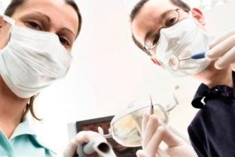

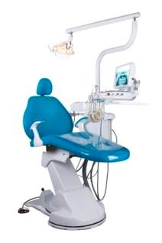
Why Should I Join the AGD?
Educational Development
Career Assistance
Networking Opportunities
Volunteer Leadership
Practice Management Tools
Advocacy & Representation
Awards & Recognition
And More!
Notes:
I’ve been a member of the AGD for {insert number} years, and it has helped me with everything from finding a practice to insurance contract analysis to discounts on personal and professional products and services.

Slide 7
What do I get for joining the AGD as a resident member?
Notes:
As a member of the AGD, you’ll get a lot of free and discounted products and services that will help you further your dental education and transition into your career. For example…(click to next slide)

Slide 8
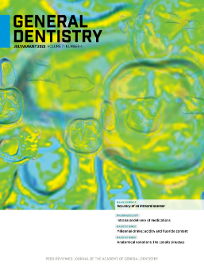

Educational Development
CE opportunities
General Dentistry and AGD Impact
Podcasts and AGD blog
AGD’s Scientific Session
Education discussion forums
Local education events
Notes:
The AGD recognizes that learning doesn’t stop once your classes end, and since continuing education is such an important part of our members’ careers, we want our new dentist members to learn the value of lifelong learning early on! That’s why we offer you the chance to earn up to 150 hours of participation credit (for a one-year residency program) and up to 300 hours of credit (for a two-year residency program) and apply it toward the prestigious AGD Fellowship Award (FAGD) and instant credibility once you graduate!
If you need research or other resources for any of your classes, or you just need some reading material for in between labs, the AGD gives you free subscriptions to our peer-reviewed journal, General Dentistry, and to our newsmagazine, AGD Impact. You can also access archives of both publications on the AGD website, as well as other online resources such as the AGD Podcast series, RSS feeds, and the AGD’s blog, The Daily Grind.
The AGD also welcomes students and residents to AGD’s yearly scientific session with a significantly reduced registration fee.
AGD member discussion forums allow you to pose questions to other general dentist members, and receive opinions and advice from like-minded professionals.
Plus, take advantage of local education events offered through your AGD constituent.

Slide 9
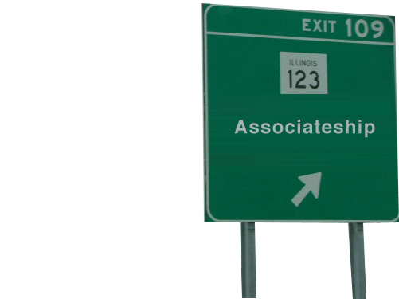
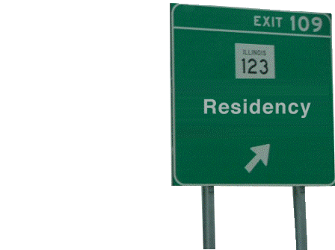
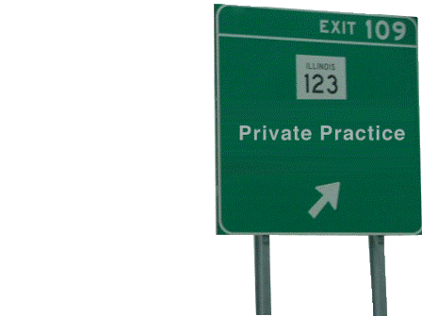
Career Assistance
AGD Career Center
Career path advice
Career discussion forums
Notes:
You can also browse the AGD Career Center to see what kinds of jobs will be waiting for you after residency, seek advice from fellow AGD members on which career path is right for you, and more.

Slide 10

Networking Opportunities
AGD social media pages
Local constituent network
Notes:
Online member discussion forums and social media sites such as Facebook, Twitter, LinkedIn, and Google+ are also great ways to network online with your peers and fellow AGD members, and stay up-to-date on the latest techniques and current news.
Your local AGD constituent likely hosts different types of networking and social events with AGD dentists in your area. These events are a great way to meet other dentists in your area and start building your network!

Slide 11

Complimentary Malpractice
Insurance
  AGD members who are new graduates are eligible for Complimentary New Graduate Professional Liability Insurance Coverage for up to 12 months of protection.
    This benefit could save you up to $24,795* in legal expenses to defend a dental malpractice claim!
  *CNA. (2016). Dental Professional Liability 2016 Claim Report.

Slide 12
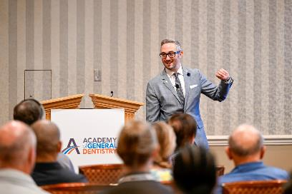
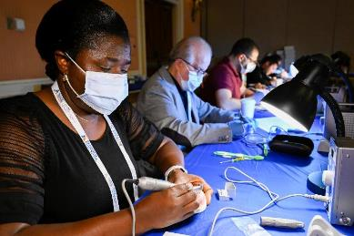
Continuing Education
Continuing Education Opportunities
- AGD CE Directory
- Free online CE
- Local programs and events
- Self-Instruction Program
- FAGD Exam Study Guide
- Online learning resources
AGD2026
- AGD’s Scientific Session
- June 24-27, 2026, in Las Vegas, NV
- Featuring the New Dentist Lounge with free CE and networking events
- www.agd2026.org
Notes:
With more than 1,900 providers approved worldwide, the AGD’s Program Approval for Continuing Education (PACE) ensures members ample CE opportunities to work toward an AGD achievement award or state relicensure. Achieve your professional and educational goals through these AGD CE opportunities:
AGD CE Directory: The AGD highlights quality educational opportunities from providers throughout the world through our convenient, searchable database.
Free online CE: AGD members can access free online CE that’s approved for Fellowship and Mastership credit.
Local Program & Events: The calendar of events contains a current listing of programs and events happening in all constituents. Please be sure to check it on a regular basis, as it will serve as the source for the latest information. If you have questions about a listed program or event, please contact the organizer located in the event listing.
Self-Instruction: The Self-Instruction program (formerly known as DART) is featured in the AGD’s bimonthly journal, General Dentistry. Each issue features three exercises, each worth two CE credits. You can use these credits toward relicensure (where self-examination credits are accepted), AGD membership maintenance, or the Fellowship award.
Fellowship Exam Study Guide: An excellent self-instruction tool, the 100-question Study Guide has been developed from the content outline of the Fellowship Exam to help facilitate learning for those members preparing to take the Fellowship Exam. Members will receive 15 continuing education hours for completing the Fellowship Exam Study Guide. Over 85% of members who use the Study Guide to prepare for the exam pass the Fellowship Exam, and the AGD also offers a Study Buddy online member discussion forum, so take advantage of these benefits when working toward the Fellowship Award!
Online learning resources: The AGD Podcast series offers members more accessible CE resources with an on-the-go learning format, and members can subscribe to a variety of RSS feeds to receive the latest dental news directly to their computers!
At the AGD annual meeting, attendees can earn CE from conference sessions presented by a global faculty of dental experts, visit hundreds of leading companies showcasing the newest products and offering CE hours for FREE on the Exhibit Hall floor, and mix and mingle at a variety of exciting social events. The next annual meeting is June 24 to 27 in Las Vegas, NV. For more details, visit www.AGD2026.org.

Slide 13
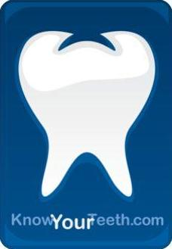

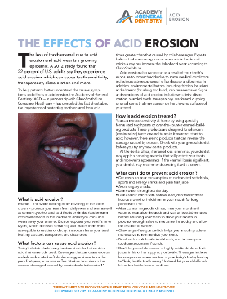
Practice Management Tools
KnowYourTeeth.com
Find an AGD Dentist patient referral service
FREE practice assistance
Product Review Directory
Patient education resources
Discounted products and services
Notes:
The AGD works hard to prepare new dentists, especially when it comes to anticipating the day-to-day challenges of building and maintaining your first practice. That’s why we not only offer new dentists a glimpse of what they can expect post-education, we also educate them on the following practice management solutions offered by the AGD to ensure that our members experience success throughout their dental careers:
KnowYourTeeth.com is our go-to resource that's been designed, first and foremost, to meet the needs of consumers who have questions and concerns about their dental care and oral health. As an AGD member, you can use this resource to educate your patients, which will improve treatment acceptance, decrease cancellations, improve office visits, and enhance your overall patient relationships.
AGD member dentists are also automatically entered into the “Find an AGD Dentist” patient referral service, which can help you build your patient network and maintain a successful dental practice. When patients search KnowYourTeeth.com or call our hotline looking for a dentist, the AGD will refer them to you if you live in their area.
As a new dentist, you’ll have to deal with a lot of insurance contracts and third-party payer issues. AGD offers members free contract analysis services through The Fine Print. AGD experts will discuss your contract with you and identify potentially harmful clauses.
Get help in deciding which dental materials or office equipment to purchase next! The AGD Product Review features evaluations of more than 200 products within 27 different product categories. Once you’ve purchased and tested the product yourself, return to the AGD Product Review to post your own personal rating for other members to see!
Other patient education resources like AGD Oral Health Fact Sheets and patient newsletters can be displayed in your office or sent electronically to inform your patients about good oral health.
And don’t forget about the many discounts on professional and personal products and services the AGD offers members to save you time and money, including discounted liability insurance for recent graduates through Dentist’s Advantage and savings on website design services through The Online Practice.

Slide 14
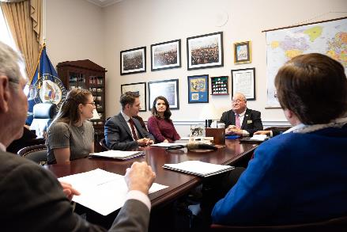
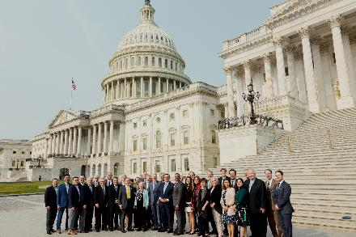
Advocacy & Representation
Hot Issues
  - Monitoring
  - Action alerts
Government Relations
- State & national legislation
- Annual Government Relations Conference
- Contact with lawmakers
Professional Relations
- ADA
- Other allied dental organizations
Public Relations
Notes:
As the general dentist’s advocate, the AGD monitors important issues that may affect the way general dentists practice both on the local and national level, and sends out action alerts to keep members in-the-know.
The AGD serves as the eyes, ears, and voice of the general dentist, advocating on behalf of its members both on the local state and national level. Members can make your voice heard by participating in an e-mail campaign to lawmakers about legislation or the annual Government Relations Conference in Washington, D.C., or by simply educating themselves about the issues online.
The AGD also acts on the general dentists’ behalf within organized dentistry, protecting their interests and collaborating to strengthen their voice among the American Dental Association , dental specialties, and other organizations.
To assist members in matters of dental care, the AGD offers the public information about advancing oral health, and provides members with the resources to advocate for the betterment of public dental health care.

Slide 15
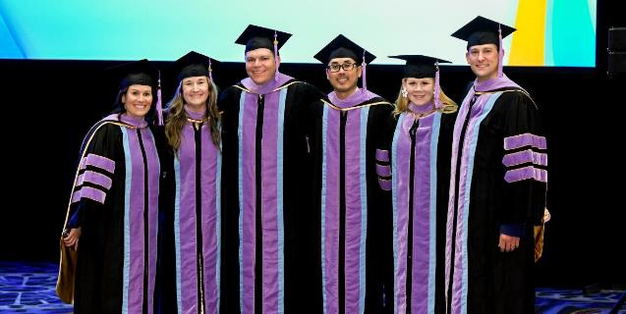
Awards & Recognition
Fellowship Award
- Residency CE credit
Mastership Award
Achievement Awards
- Nominate your colleagues
- Nominate your constituent
Notes:
Distinguish yourself professionally through continuing education with the only achievement-based awards in general dentistry, the AGD Fellowship and Mastership Awards!
Individuals who join the AGD within four years of completing a one-year CODA-accredited advanced dental education program (AEGD/GDR/GPR) may earn up to 150 hours of participation credit, and up to 300 hours of credit for a two-year program. Credit can be received for non-concurrent completion of both program types for a maximum of 450 hours of participation credit.
AGD members can also nominate their colleagues for their achievements in general dentistry, or recognize their constituent for doing an outstanding job in serving its members.

Slide 16

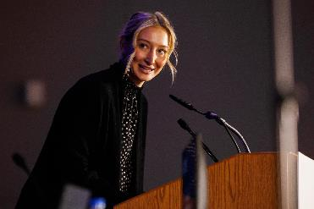
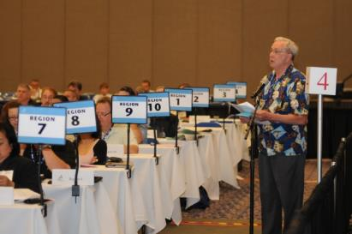
Leadership Opportunities
Call for Volunteer Leaders
- Unite organized dentistry
- Give back to the profession
- Develop leadership skills
- Enhance public awareness
- Network with peers
Volunteer Opportunities
- Local level: Conduct CE courses, review
articles, or represent your constituent
- National level: Participate in the council
or committee structure, or become a
public liaison
Notes:
The AGD is always looking for great national and local leaders, and volunteering for a leadership position is an excellent way to give back to your profession and your patients.
By getting involved in the AGD through the Call for Volunteer Leaders, you’ll receive both personal and professional benefits. You’ll benefit from:
Recognition as a leader who has a commitment to the profession.
An opportunity to network with peers in the profession.
Possible speaking opportunities.
Innovative ideas to use in your practice.
Leadership development training.
Experience in leadership for future roles in the association.
And your profession will receive:
Enhanced public awareness about dentistry.
Guided development of valuable products and services for members.
Determined rules, regulations, and laws that govern the profession.
Unity within organized dentistry.
Local and national leadership in the U.S. and Canada strive to recruit future leaders for the AGD. These individuals serve the AGD by:
Planning and conducting local continuing education courses
Participating as members of constituent and regional board of directors
Serving on a national level in the council and committee structure
Types of volunteer opportunities include:
Council/Committee Assignment: Support the goals and objectives of the AGD’s strategic plan, AGD 2010.
Task Force Assignment: Address a specific issue for a specified period of time.
Author: Write articles for the AGD constituent publications.
Reviewer: Review articles for the AGD publications.
Constituent Speaker/Spokesperson Bureau: Represent the AGD at various presentations (schools, health fairs, etc.) or in media interviews as an expert on a variety of oral health topics.
Constituent Volunteer: Serve an AGD constituent by giving time in an area of interest or for a specific project.
Public Liaison: Interact with the general public to increase dental awareness.
Liaison to Other Dental Organizations: Represent the AGD at meetings of other dental organizations.

Slide 17
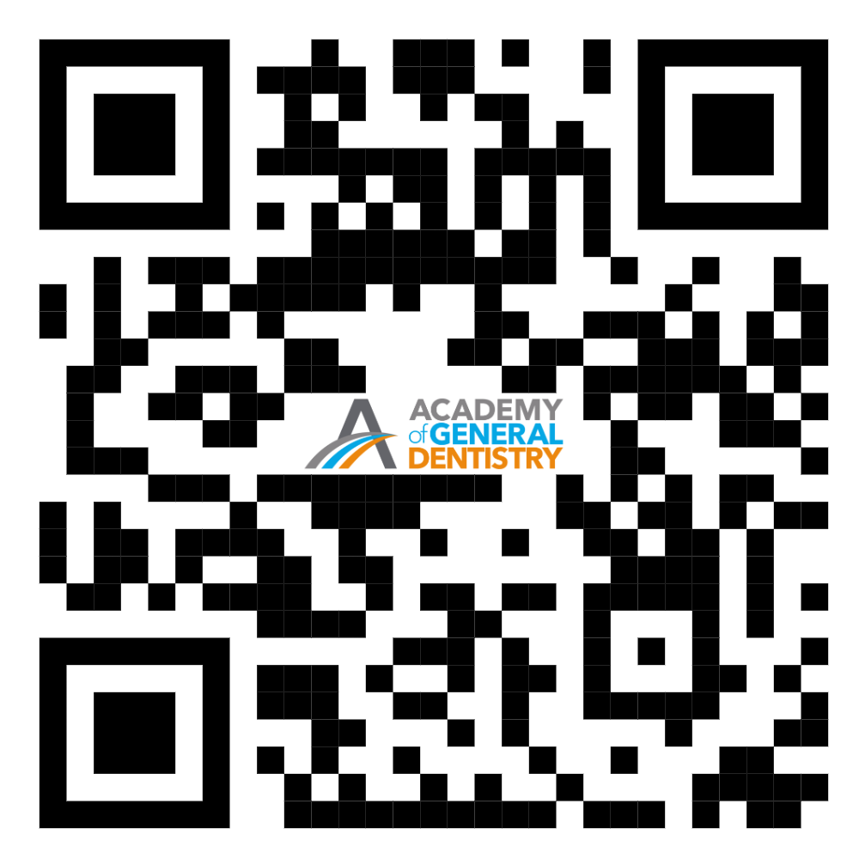
Join the AGD Today!
Continue your career evolution for just $22.
To join online, scan the QR code below or visit www.agd.org/JOIN.
Contact the AGD Membership Services Center at 888.243.3368 or email us at membership@agd.org.
Notes:
Resident membership only costs $22 a year! We know how tight money can be while you’re continuing your education, and we’re giving you this significant discount because we want you to take advantage of all the benefits we have to offer you.
And this is just the tip of the iceberg. You can find more information about other member benefits online at www.agd.org.
The AGD has helped me so much throughout my career, and I hope that you take advantage of all of the things the AGD offers to help you through your career evolution.

Slide 18

Questions?
Notes:
At this point, answer any questions the attendees might have.

Slide 19
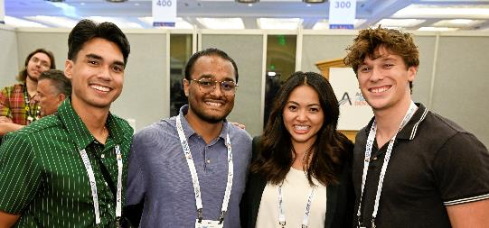
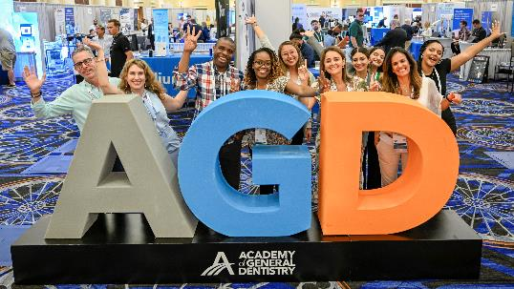
Contact Us!
AGD Headquarters
www.agd.org
888.AGD.DENT (888.243.3368)
membership@agd.org
560 W. Lake St., Sixth Floor
Chicago, IL 60661
Locally
{Insert your constituent’s local
contact information here}
Stay Social with the AGD!
Like us on Facebook, follow us on Instagram and Twitter, and connect with us on LinkedIn.
Notes:
Provide AGD Headquarters contact information, as well as your own local contact information, and be sure to inform attendees of the AGD’s social media accounts and any local programs, events, etc., coming up.
Thank you!

Slide 20
Thank You!

