Slide 1


Slide 2

The Academy of General Dentistry
Your Voice for Excellence through Education and Advocacy

Slide 3
{Insert Name of Presenter}
{Insert bullet point #1 about presenter}
{Insert bullet point #2 about presenter}
{Insert bullet point #3 about presenter}
{….}
Notes:
Use this slide to introduce the presenter(s), and include name, dental school(s), achievements, and other points of interest to engage your dental student audience.

Slide 4

Who is the AGD?
The second largest dental association in the U.S.
The only dental association that exclusively serves the needs and represents the interests of the general dentist
Your voice for excellence through education and advocacy
Notes:
Other allied dental organizations such as the American Academy of Cosmetic Dentistry, Academy of Laser Dentistry, and Academy of Implant Dentistry look to the AGD for leadership in issues affecting the general dentistry community.
When the ADA needs input on issues affecting the general dentist, the AGD is the primary community of interest invited for that input.
We have approximately 38,000 members throughout the United States and Canada.

Slide 5
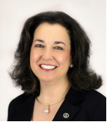
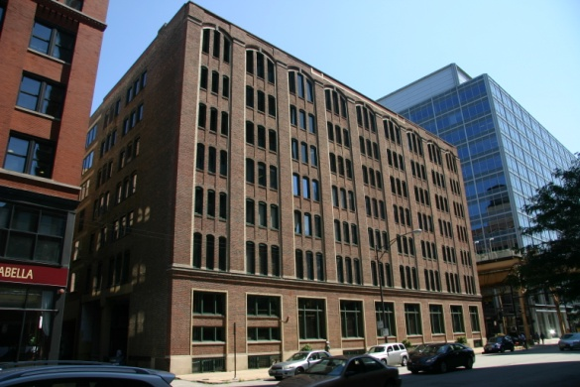
About the AGD
Core Values
  Excellence in oral health care
  Diversity
  Universal acceptance of the general
  dentist as a gatekeeper of oral
  health care
  Continuous, lifelong learning
  Advocacy and representation
  Teamwork, camaraderie, and
  mentorship
  Ethical, honest, and credible
  behavior
General Information
Formed in 1952
Headquartered in Chicago, Ill.
More than 38,000 total members,
including over 4,000 dental students
2016-2017 President: Maria Smith,
DMD, MAGD

Slide 6


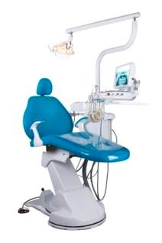
Why Should I Join the AGD?
Educational Development
Career Assistance
Networking Opportunities
Volunteer Leadership
Practice Management Tools
Advocacy & Representation
Awards & Recognition
And More!
Notes:
I’ve been a member of the AGD for {insert number} years, and it has helped me with everything from finding a practice to insurance contract analysis to discounts on personal and professional products and services.
The AGD offers dental students great benefits, too, that are designed to guide you toward a successful career. As a student member, you’ll receive resources for furthering your education, advice to help you in your transition from student to new dentist, and so much more. After graduation, take advantage of all of the AGD’s practice management tools, stay up-to-date on the latest techniques with high-quality CE courses, and find your voice both in your career and in the general dentistry profession.

Slide 7
What do I get for joining the AGD as a student member?
Notes:
As a member of the AGD, you’ll get a lot of free and discounted products and services that will help you further your dental education and transition into your career. For example…(click to next slide)

Slide 8

Educational Development
AGD Student CE policy
AGD Mentor Program
General Dentistry and AGD Impact
Podcasts and AGD blog
FREE registration to AGD2017, AGD’s Annual Meeting
Education discussion forums
Local education events
Notes:
The AGD recognizes that learning doesn’t stop once your classes end, and since continuing education is such an important part of our members’ careers, we want our student members to learn the value of lifelong learning early on! That’s why we offer you the chance to earn up to 50 hours of CE lecture credit while you’re still in school, and apply it toward the prestigious AGD Fellowship Award (FAGD) and instant credibility once you graduate!
In addition, the AGD Mentor Program is a great way to seek one-on-one advice and knowledge from an experienced general dentist member while you’re still in school, and career guidance as you prepare to graduate.
If you need research or other resources for any of your classes, or you just need some reading material for in between labs, the AGD gives you free subscriptions to our peer-reviewed journal, General Dentistry, and to our newsmagazine, AGD Impact, available in both print and interactive, digital editions. You can also access archives of both publications on the AGD website, as well as other online resources such as the AGD Podcast series, RSS feeds, and the AGD’s blog, The Daily Grind.
The AGD also welcomes students to AGD2017 with a waived registration fee. Students are invited to attend lectures and capsule clinics, browse the Exhibit Hall, and more—all for FREE!
AGD member discussion forums allow you to pose questions to other general dentist members, and receive opinions and advice from like-minded professionals.
Plus, take advantage of local education events designed especially for students and often offered through your local dental school or AGD constituent.

Slide 9
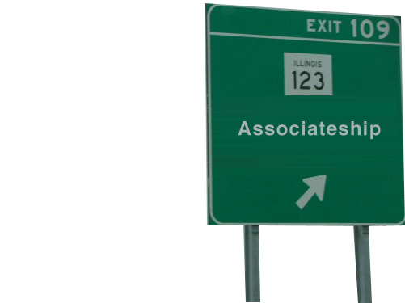
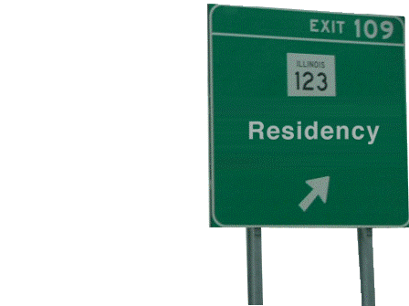
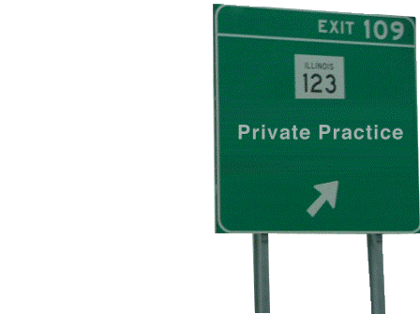
Career Assistance
AGD Mentor Program
AGD Career Center
Career path advice
Career discussion forums
Student transition manual
Notes:
Again, the AGD Mentor Program allows you to gain crucial career advice even before you graduate, so you can find success in your new career early on!
You can also browse the AGD Career Center to see what kinds of jobs will be waiting for you after graduation, seek advice from fellow AGD members on which career path is right for you, and more.
Plus, the AGD’s free student transition manual outlines everything you’ll need to know about transitioning from dental student to dental professional, including how to set up and manage your first dental practice.

Slide 10

FREE Student Transition Manual
You’ve Graduated, Now What?
  Get all of the practice start-up information they won’t tell you in school, from experienced dentists:
    Getting started
    Financial planning
    Advancing your career
    Checklists & interactive forms
Manual available for download from the AGD website.
Created by the AGD in partnership with Dentist’s Advantage and the AGD Foundation.
Notes:
If you’re worried about transitioning from dental school to practice, the AGD has created a student and recent graduate manual, You’ve Graduated, Now What? A Guide to Navigating Those First Years in the Dental Profession.
This manual covers everything you need to know about starting your new business including:
Getting started - Setting up a practice and goals.
Financial planning - How to handle debt and other obstacles.
Advancing your career - Continue to go above and beyond after your practice is established.
Easy to use checklists and interactive forms.
Student members can download the manual for FREE from www.agd.org/students/career/manual.asp!

Slide 11

Networking Opportunities
FREE registration to AGD 2016, AGD’s annual meeting
AGD FellowTrack program
Lunch & Learns
ASDA meetings & events
AGD social media pages
Local constituent network
Notes:
If you want to network with fellow classmates and future colleagues, take advantage of the free registration we offer to students who attend the AGD annual meeting. The next annual meeting will take place June 18 to 21, 2015, in San Francisco, so mark your calendars today! While you’re there, you’ll have access to top-notch continuing education courses, an innovate Exhibit Hall, exciting social events, and more!
The AGD also has the FellowTrack program, a collaborative program run through select AGD constituents and their nearby dental schools. The FellowTrack program:
Connects you with mentors
Builds relationships with faculty and AGD leaders
Prepares you for Fellowship (FAGD)
Allows you to participate in original CE opportunities outside of your dental school curriculum
Grooms you as a leader
The AGD encourages its constituents to host frequent Lunch & Learns at local dental schools to build a positive presence with school administrators and students, and to expose you to the various companies and product suppliers you’ll find yourself working with after you graduate. Students are also encouraged to get involved in the event planning and organizing.
The AGD also goes where the American Student Dental Association (ASDA) goes in order to stay connected with students like you throughout the country! Learn about finding your path to success with AGD membership and connect with leaders and staff at ASDA student events across the country, including the Annual Session, National Dental Student Lobby Day, and National Leadership Conference.
And, finally, online member discussion forums and social media sites such as Facebook, Twitter, LinkedIn, and Google+ are also great ways to network online with your peers and fellow AGD members, and stay up-to-date on the latest techniques and current news.

Slide 12
What can the AGD do
for me after graduation?
Notes:
There are a lot of things the AGD can do to help you as you transition from dental school to practice and beyond. For example…(click to next slide)

Slide 13
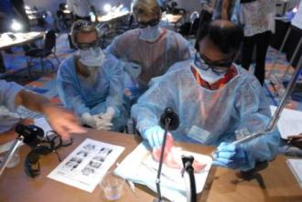
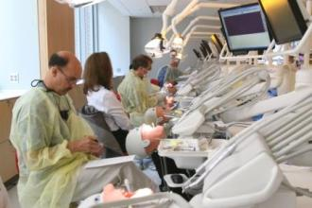
Continuing Education
Continuing Education Opportunities
- AGD CE Directory
- Free online CE
- Local programs and events
- Self-Instruction Program
- FAGD Exam Study Guide
- Online learning resources
AGD2017
- AGD’s annual meeting
- July 13 to 15, 2016, in Las Vegas
- CE, exhibitors, and social events
- www.agd2017.org
Notes:
With more than 1,900 providers approved worldwide, the AGD’s Program Approval for Continuing Education (PACE) ensures members ample CE opportunities to work toward an AGD achievement award or state relicensure. Achieve your professional and educational goals through these AGD CE opportunities:
AGD Annual Meeting & Exhibits: The AGD Annual Meeting & Exhibits offers the most up-to-date and practical continuing dental education (CE). With lectures and hands-on courses available, you’ll learn tips and techniques that will set you apart from the competition once you graduate.
AGD CE Directory: The AGD highlights quality educational opportunities from providers throughout the world through our convenient, searchable database.
Free online CE: AGD members can access free online CE that’s approved for Fellowship and Mastership credit through Procter & Gamble.
Local Program & Events: The calendar of events contains a current listing of programs and events happening in all constituents. Please be sure to check it on a regular basis, as it will serve as the source for the latest information. If you have questions about a listed program or event, please contact the organizer located in the event listing.
Self-Instruction: The Self-Instruction program (formerly known as DART) is featured in the AGD’s bimonthly journal, General Dentistry. Each issue features three exercises, each worth two CE credits. You can use these credits toward relicensure (where self-examination credits are accepted), AGD membership maintenance, or the Fellowship award.
Fellowship Exam Study Guide: An excellent self-instruction tool, the 100-question Study Guide has been developed from the content outline of the Fellowship Exam to help facilitate learning for those members preparing to take the Fellowship Exam. Members will receive 15 continuing education hours for completing the Fellowship Exam Study Guide. Over 85% of members who use the Study Guide to prepare for the exam pass the Fellowship Exam, and the AGD also offers a Study Buddy online member discussion forum, so take advantage of these benefits when working toward the Fellowship Award!
Online learning resources: The AGD Podcast series offers members more accessible CE resources with an on-the-go learning format, and members can subscribe to a variety of RSS feeds to receive the latest dental news directly to their computers!
At the AGD annual meeting, attendees can earn CE from conference sessions presented by a global faculty of dental experts, visit hundreds of leading companies showcasing the newest products and offering CE hours for FREE on the Exhibit Hall floor, and mix and mingle at a variety of exciting social events. The next annual meeting is June 13 to 15, 2017, in Las Vegas. For more details, visit www.agd2017.org.

Slide 14

AGD Career Center
Join a practice
Buy a practice
Purchase office equipment
Hire dental team members
Post your resume or CV for FREE
Set up job alerts
Notes:
As you’re deciding on what to do after graduation, check out the AGD’s online career center. Not only can you post your resume or CV for free, but you can also search available job postings and set up alerts, and look for practices to join or buy.
If you know you’ll be starting your own practice, you can also find equipment and dental team members there, as well.

Slide 15
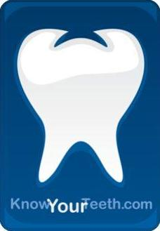

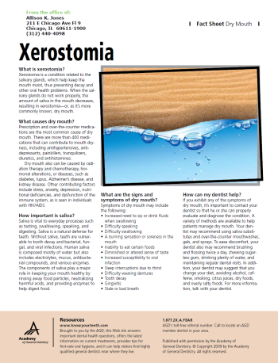
Practice Management Tools
KnowYourTeeth.com
Find an AGD Dentist patient referral service
FREE practice assistance
Product Review Directory
Patient education resources
Discounted products and services
Notes:
The AGD works hard to prepare students for life after dental school, especially when it comes to anticipating the day-to-day challenges of building and maintaining your first practice. That’s why we not only offer students a glimpse of what they can expect post-graduation, we also educate them on the following practice management solutions offered by the AGD to ensure that our members experience success throughout their dental careers:
KnowYourTeeth.com is our go-to resource that's been designed, first and foremost, to meet the needs of consumers who have questions and concerns about their dental care and oral health. As an AGD member, you can use this resource to educate your patients, which will improve treatment acceptance, decrease cancellations, improve office visits, and enhance your overall patient relationships.
AGD member dentists are also automatically entered into the “Find an AGD Dentist” patient referral service, which can help you build your patient network and maintain a successful dental practice. When patients search KnowYourTeeth.com or call our hotline looking for a dentist, the AGD will refer them to you if you live in their area.
As a new dentist, you’ll have to deal with a lot of insurance contracts and third-party payer issues. AGD offers members free contract analysis services through The Fine Print. AGD experts will discuss your contract with you and identify potentially harmful clauses.
Get help in deciding which dental materials or office equipment to purchase next! The AGD Product Review features evaluations of more than 200 products within 27 different product categories. Once you’ve purchased and tested the product yourself, return to the AGD Product Review to post your own personal rating for other members to see!
Other patient education resources like AGD Oral Health Fact Sheets and patient newsletters can be displayed in your office or sent electronically to inform your patients about good oral health.
And don’t forget about the many discounts on professional and personal products and services the AGD offers members to save you time and money, including discounted liability insurance for recent graduates through Dentist’s Advantage and savings on website design services through The Online Practice.

Slide 16
FREE Practice Assistance*
Contract Analysis
  - PPO and other insurance contracts
  - NEW! DSO and other management contracts
Dental Insurance Claims Assistance
Online Library of Common Practice Documents
- Patient consent forms
- Employee forms
- Practice policy forms
And More …
* These services do not constitute legal assistance and do not replace consulting with your own attorney, which is always recommended.

Slide 17
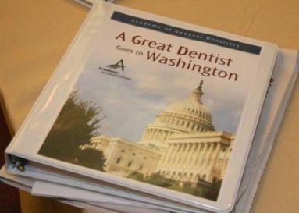
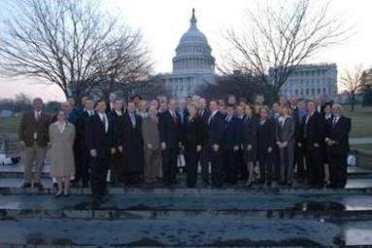

Advocacy & Representation
Hot Issues
  - Monitoring
  - Action alerts
Government Relations
- State & national legislation
- Annual Government Relations Conference
- Contact with lawmakers
Professional Relations
- ADA
- Other allied dental organizations
Public Relations
Notes:
As the general dentist’s advocate, the AGD monitors important issues that may affect the way general dentists practice both on the local and national level, and sends out action alerts to keep members in-the-know.
The AGD serves as the eyes, ears, and voice of the general dentist, advocating on behalf of its members both on the local state and national level. Members can make your voice heard by participating in an e-mail campaign to lawmakers about legislation or the annual Government Relations Conference in Washington, D.C., or by simply educating themselves about the issues online.
The AGD also acts on the general dentists’ behalf within organized dentistry, protecting their interests and collaborating to strengthen their voice among the American Dental Association , dental specialties, and other organizations.
To assist members in matters of dental care, the AGD offers the public information about advancing oral health, and provides members with the resources to advocate for the betterment of public dental health care.

Slide 18


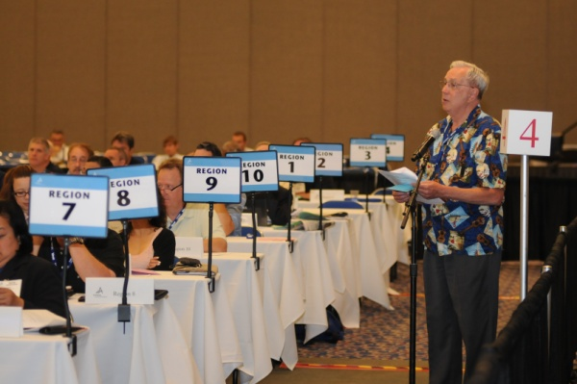
Leadership Opportunities
Call for Volunteer Leaders
- Unite organized dentistry
- Give back to the profession
- Develop leadership skills
- Enhance public awareness
- Network with peers
Volunteer Opportunities
- Local level: Conduct CE courses, review
articles, or represent your constituent
- National level: Participate in the council
or committee structure, or become a
public liaison
Notes:
The AGD is always looking for great national and local leaders, and volunteering for a leadership position is an excellent way to give back to your profession and your patients.
By getting involved in the AGD through the Call for Volunteer Leaders, you’ll receive both personal and professional benefits. You’ll benefit from:
Recognition as a leader who has a commitment to the profession.
An opportunity to network with peers in the profession.
Possible speaking opportunities.
Innovative ideas to use in your practice.
Leadership development training.
Experience in leadership for future roles in the association.
And your profession will receive:
Enhanced public awareness about dentistry.
Guided development of valuable products and services for members.
Determined rules, regulations, and laws that govern the profession.
Unity within organized dentistry.
Local and national leadership in the U.S. and Canada strive to recruit future leaders for the AGD. These individuals serve the AGD by:
Planning and conducting local continuing education courses
Participating as members of constituent and regional board of directors
Serving on a national level in the council and committee structure
Types of volunteer opportunities include:
Council/Committee Assignment: Support the goals and objectives of the AGD’s strategic plan, AGD 2010.
Task Force Assignment: Address a specific issue for a specified period of time.
Author: Write articles for the AGD constituent publications.
Reviewer: Review articles for the AGD publications.
Constituent Speaker/Spokesperson Bureau: Represent the AGD at various presentations (schools, health fairs, etc.) or in media interviews as an expert on a variety of oral health topics.
Constituent Volunteer: Serve an AGD constituent by giving time in an area of interest or for a specific project.
Public Liaison: Interact with the general public to increase dental awareness.
Liaison to Other Dental Organizations: Represent the AGD at meetings of other dental organizations.

Slide 19
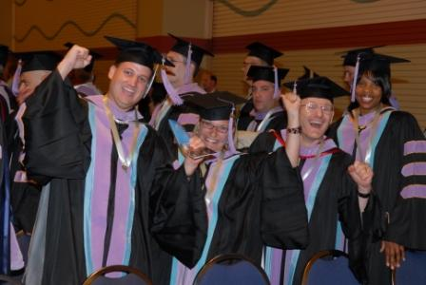

Awards & Recognition
Fellowship Award
- Student CE credit
- Residency CE credit
Mastership Award
Achievement Awards
- Nominate your colleagues
- Nominate your constituent
Notes:
Distinguish yourself professionally through continuing education with the only achievement-based awards in general dentistry, the AGD Fellowship and Mastership Awards!
Upon graduation, the lecture credit hours you earned as a student will be applied toward the requirements for achieving your Fellowship Award.
Additionally, individuals who join the AGD within four years of completing a one-year CODA-accredited advanced dental education program (AEGD/GDR/GPR) may earn up to 150 hours of participation credit, and up to 300 hours of credit for a two-year program. Credit can be received for non-concurrent completion of both program types for a maximum of 450 hours of participation credit.
AGD members can also nominate their colleagues for their achievements in general dentistry, or recognize their constituent for doing an outstanding job in serving its members.

Slide 20
Join the AGD Today!
Continue your career evolution for just $17.
Get special discounted rates for four years following graduation.
To join online, visit www.agd.org/JOIN.
Contact the AGD Membership Services Center at 888.AGD.DENT (888.243.3368) or email us at membership@agd.org.
Notes:
At this point, I bet you’re thinking to yourself, “AGD membership sounds great and all…but I’m a student, and I’m broke. How can I possibly afford this?”
Well, student membership only costs $17 a year! We know how tight money can be while you’re in school, and we’re giving you this significant discount because we want you to take advantage of all the benefits we have to offer you.
Also, as your career evolves from student to new dentist, you’ll enjoy special discounted membership rates for four years after you graduate.
And this is just the tip of the iceberg. You can find more information about other member benefits online at www.agd.org.
The AGD has helped me so much throughout my career, and I hope that you take advantage of all of the things the AGD offers to help you through your career evolution. I have applications here that you can fill out, or you can also join online.

Slide 21

Questions?
Notes:
At this point, answer any questions the students might have.

Slide 22

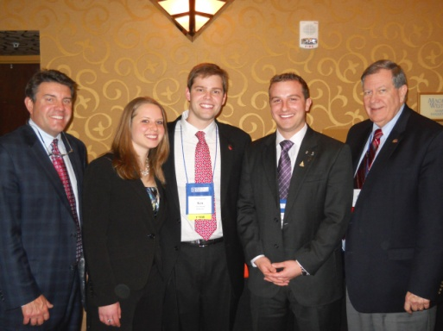

Contact Us!
AGD Headquarters
www.agd.org
888.AGD.DENT (888.243.3368)
membership@agd.org
560 W. Lake St., Sixth Floor
Chicago, IL 60661
Locally
{Insert your constituent’s local
contact information here}
Stay Social with the AGD!
Like us on Facebook, follow us on Instagram and Twitter, and connect with us on LinkedIn.
Notes:
Provide AGD Headquarters contact information, as well as your own local contact information, and be sure to inform attendees of the AGD’s social media accounts and any local programs, events, etc., coming up.
Thank you!

Slide 23
Thank You!

