Slide 1
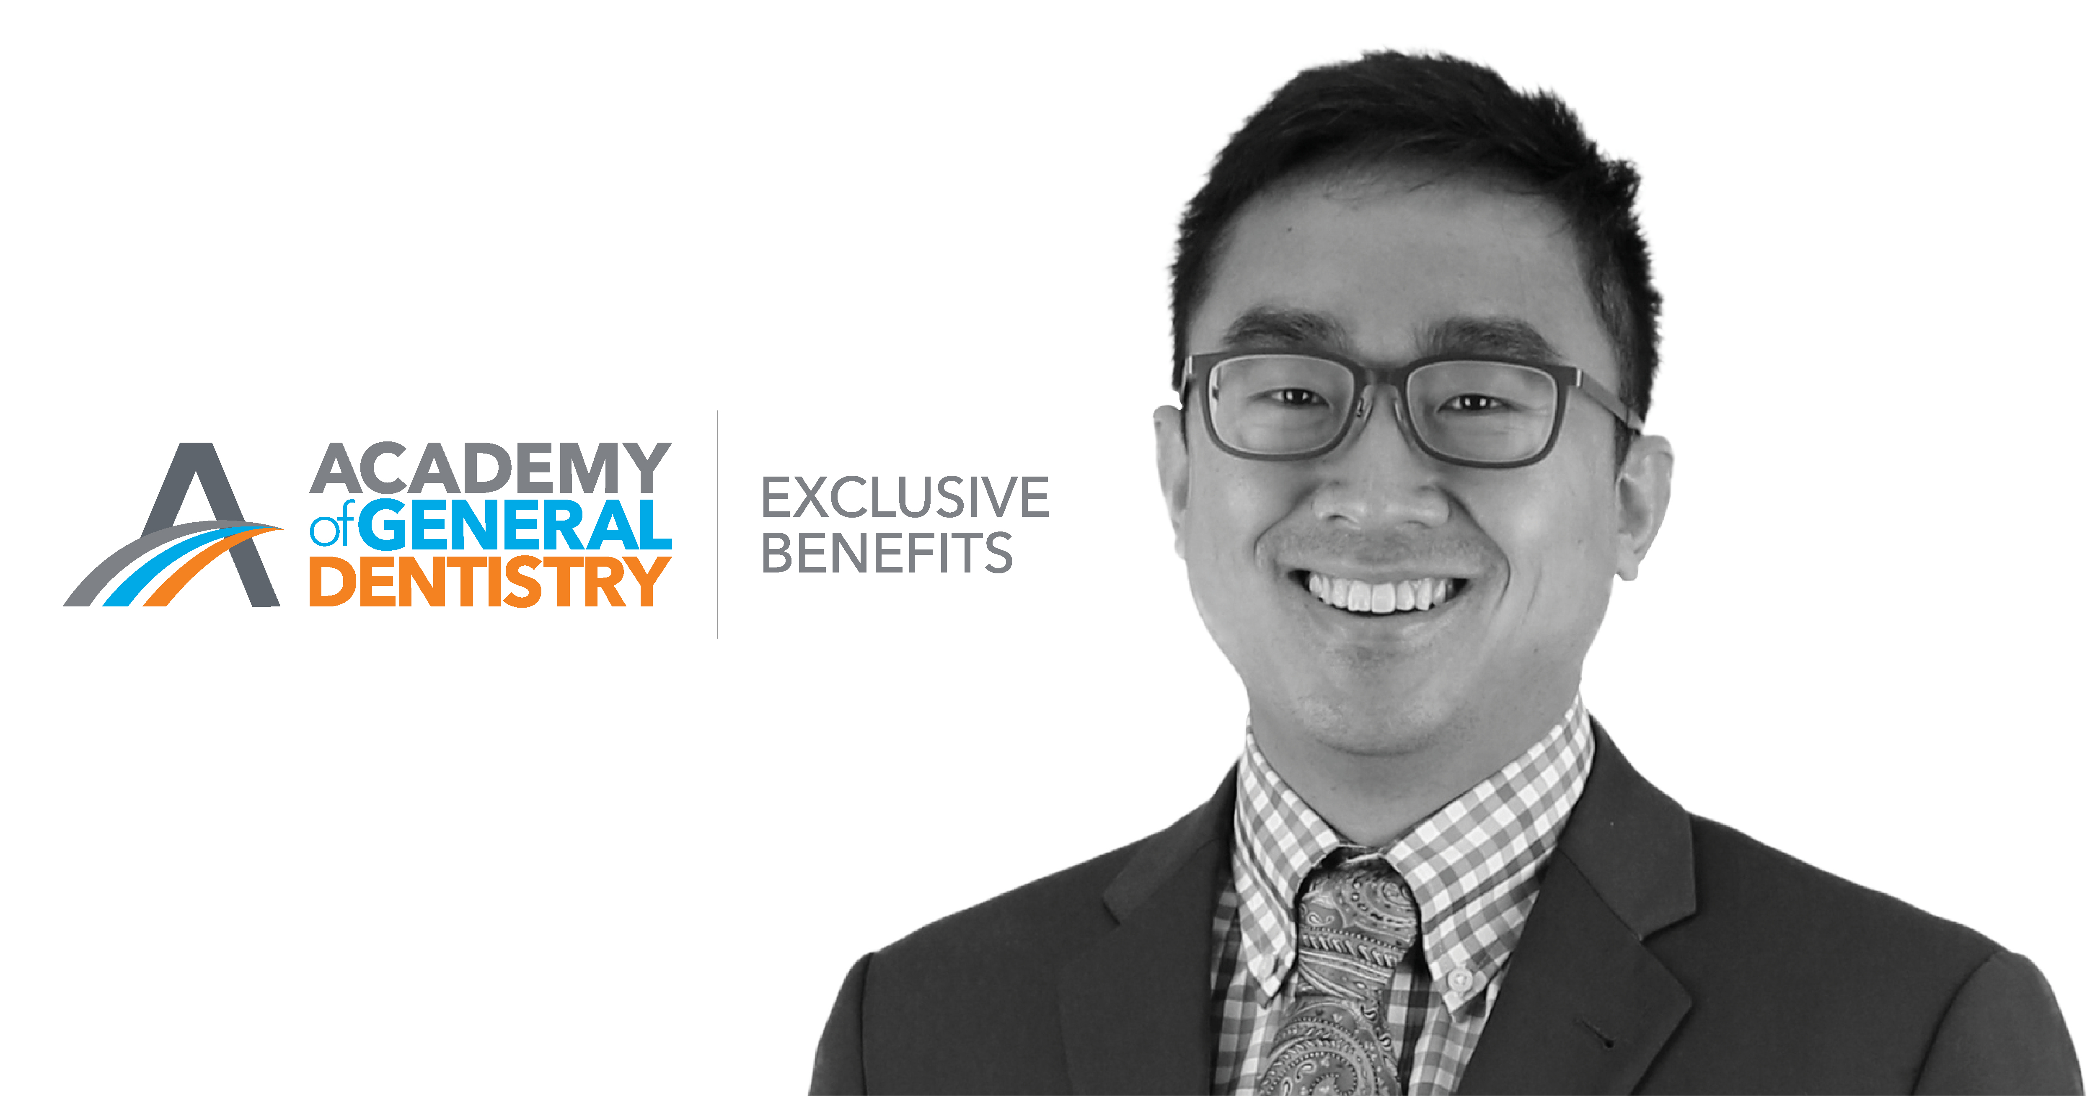
Notes:
AGD understands the needs of general dentists and works tirelessly to bring you exclusive benefits with special offers on various insurance, business, personal and practice management products and services. Before you make a purchase for your business, or for yourself, be sure to visit the AGD Exclusive Benefits site to see if we have a better offer for you.

Slide 2
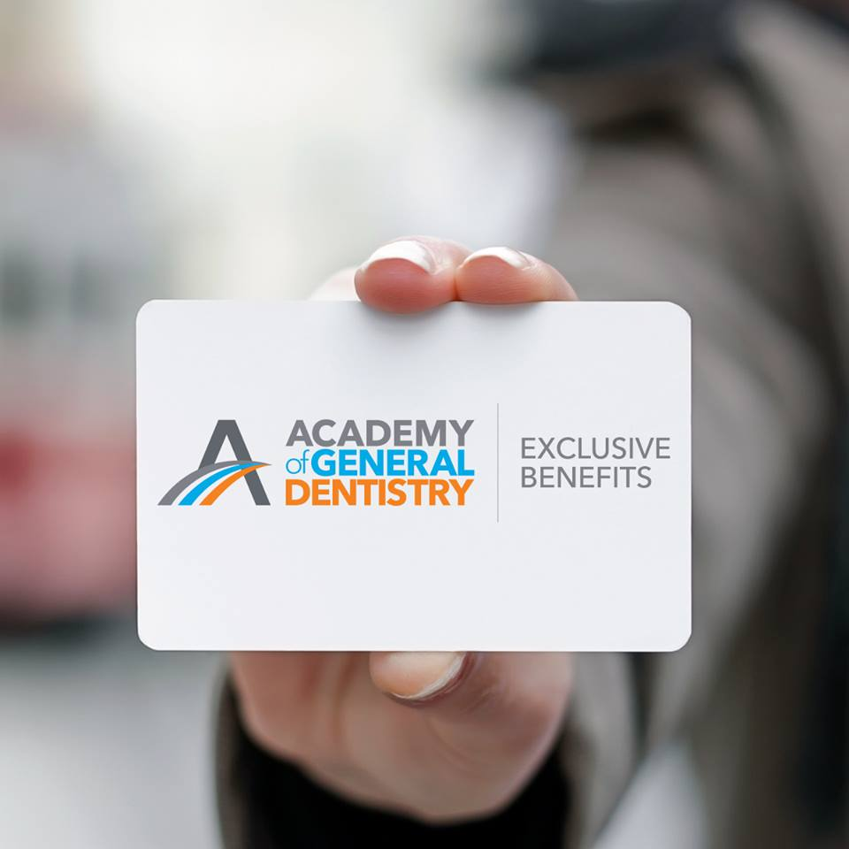
AGD Members Save On:
Education
Insurance
Practice Management
Practice Technology
Travel

Slide 3
Notes:
You know the value of saving a dollar. That's why we want to make sure you're taking full advantage of all the offers and discounts that come along with being a member of AGD. From dental school to retirement, AGD offers benefits that cater to the changing needs of our members at every stage of their dental career.

Slide 4
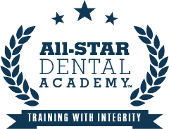
Education
All-Star Dental Academy
Dental Office Training
Offer Information
As an AGD member, you will receive a $400 discount on the first year of the program.
Notes:
All-Star Dental Academy offers the dental industry’s most comprehensive online customer-service-based training program. It provides dentists with a simple, step-by-step customer-service process. Its 24/7 online training platform empowers dentists and teams to train when they want to, and their courses are delivered in bite-sized installments for effective learning, consistency and maximum retention. All-Star Dental Academy is an AGD PACE-approved provider.

Slide 5
Insurance
Dentist’s Advantage
Professional Liability Insurance
Hagan Barron Intermediaries
Personal Liability Insurance
Healthy Paws Pet Insurance
Liberty Mutual Insurance
Auto and Home Insurance
“I received the coverage I need without having to worry about the expense as a new dentist.”
Joe W. Wolski, DMD
Member since 2015

Slide 6
Offer Information
As a qualified AGD member who is graduating from dental school or will be completing an accredited general dentistry residency program in 2018, you can secure AGD New Graduate Professional Liability Insurance Coverage to receive up to 12 months of coverage at no cost to you.*
AGD members also can receive 10 percent premium credits on their professional liability insurance coverage. If you are an AGD Fellow or Master, you can receive premium credits of 15 and 20 percent, respectively.**
Legal Disclaimer
*/** Visit agd.org/exclusive-benefits for additional details
Notes:
Dentist’s Advantage offers individual professional liability insurance for dentists and their practices, with coverage limit options, claims management services and a dedicated claims consultant.
*The cost of coverage is assumed by AGD. Policy coverage is effective May 1, 2018, through April 30, 2019, for qualified applicants who enroll by April 30, 2018; for those who sign up after this date, coverage applies from the enrollment date through April 30, 2019. Qualified applicants must graduate from an accredited U.S. or Canadian dental school or complete an accredited U.S. or Canadian general dentistry residency program between Jan. 1 and Dec. 31, 2018; be entering their first year of licensed dental practice in the U.S.; be an active AGD member at the time of enrollment; and maintain active AGD membership through Dec. 31, 2018.
**Maximum credit is 60 percent, except for AGD New Graduate Professional Liability Insurance Coverage.
Dentist’s Advantage is a division of Affinity Insurance Services, Inc.; (TX 13695); (AR244489); in CA & MN, AIS Affinity Insurance Agency, Inc. (CA0795465); in OK, AIS Affinity Insurance Services, Inc.; in CA, Aon Affinity Insurance Services, Inc., (CA 0G94493), Aon Direct Insurance Administrators and Berkely Insurance Agency; and in NY, AIS Affinity Insurance Agency.

Slide 7
Offer Information
As an AGD member, you can access HBI’s insurance member benefits tailored to you, your practice and your family.
HBI is the endorsed broker/marketer for comprehensive insurances member benefits for you, the AGD member.
Group long-term disability income
Group business overhead expense
Group accidental death and dismemberment
Group term life
10-year level term life
Health insurance
Long-term care
Human resource services
Notes:
HBI is the endorsed broker/marketer for comprehensive insurances member benefits for you, the AGD member. For more than 25 years, HBI has partnered with associations such as AGD to offer innovative insurance solutions with only the highest rated insurance carrier partners.

Slide 8
Offer Information
AGD members save up to 10 percent off monthly premiums for the life of the policy. Signing up is easy. You can get a free quote and enroll in minutes.
Get your free no-obligation quote today!
Notes:
Healthy Paws Pet Insurance plan reimburses up to 90 percent of veterinary costs with no annual or lifetime caps on payouts.
Healthy Paws is the #1 customer-rated pet insurance company in 2015, 2016 & 2017. Payments are based on your actual veterinary bill and cover injuries, illnesses, emergencies, genetic conditions and much more. Simply take a picture of the vet bill and submit it for payment. Easy!
If your pet needs treatment for an accident or illness (except pre-existing conditions), you’re covered. It’s that simple. One Plan. Four Paws. All Covered!TM

Slide 9
Offer Information
As an AGD member, you can access savings on quality auto and home insurance.*
Notes:
Liberty Mutual Insurance is committed to providing insurance products and services to meet the needs of individuals, families and businesses.
*Discounts and savings are available where state laws and regulations allow, and may vary by state. Certain discounts apply to specific coverages only. To the extent permitted by law, applicants are individually underwritten; not all applicants may qualify.

Slide 10
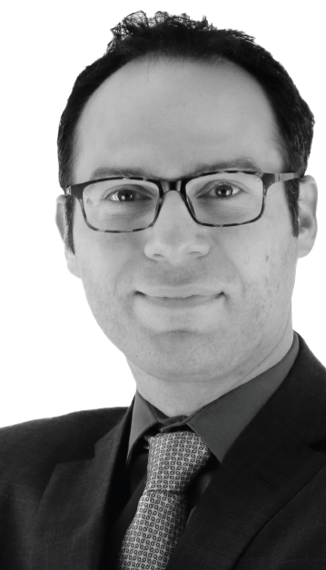
Practice
Management
CareCredit
Patient Financing
Dental Card Services Alliance
Credit Card Processing
Earnest
Student Loan Refinancing
“CareCredit helps my patients afford treatment.”
Stephen A. Ghareeb, DDS, FAGD
Member since 2004

Slide 11
Offer Information
As an AGD member, you can get started with CareCredit for only $25 — a $165 savings! CareCredit also provides you with free training and resources, many developed in conjunction with leading dental educators, and more.
Notes:
For more than 25 years, CareCredit has helped millions of patients receive needed and desired care. CareCredit is a health, wellness and beauty credit card that can be used as a financing option for certain expenses not covered by insurance or to bridge payment when desired care exceeds insurance coverage. CareCredit is accepted at more than 180,000 enrolled providers nationwide.

Slide 12
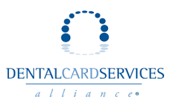
Offer Information
As an AGD member, you can save an average of 30 percent (or $3,145) per year on credit card processing.
Notes:
Created by dentists for dentists, Dental Card Services helps its partners save money on merchant processing. Dental Card Services provides practices with merchant processing plans that include transparent fees, allowing practices to calculate bottom-line savings. All processors provide transparent interchange cost, plus credit card processing programs and wholesale equipment pricing.

Slide 13
Offer Information
Earnest has partnered with AGD to offer student loan refinancing to AGD members. Members get a $400 bonus when they refinance their loans with Earnest.
Notes:
Earnest is a technology company using cutting-edge data science, smarter design, and software automation to rebuild financial services. Founded on the belief that financially responsible people deserve better options and access to credit, Earnest's lending products are built for a new generation seeking to reach life's milestones. The company uses data and technology to understand every applicant's unique financial story and offer the lowest possible rates. On average, DDS graduates have saved $51,741 on their student loans by refinancing with Earnest. Refinancing is a great solution for employed or soon-to-be-employed graduates who have high-interest, unsubsidized Direct Loans, Graduate PLUS loans, and/or private loans. Earnest’s student loan refinancing helps you pay down your federal and private student loans on your terms. Earnest consolidate as many of your existing student loans as you’d like at a lower rate, with the option to choose between a fixed or variable rate at a term that fits your exact needs. They can refinance a minimum of $5,000 of eligible student loans, up to $500,000.

Slide 14
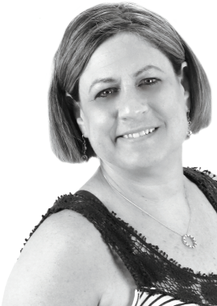
Practice
Technology
Officite
Web Presence Solution
The Online Practice
Online Marketing Tools
“I use The Online Practice for my website.”
Shari L. Hyder, DMD, MAGD
Member since 1986

Slide 15
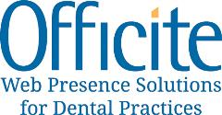
Offer Information
As an AGD member, you can receive up to 37 percent off Officite’s web presence packages.
Notes:
Officite is a leading provider of practice websites and online marketing solutions. These complete online marketing options help dental practices attract more new patients through customized strategies. Officite assists you with boosting your search engine optimization results, providing patient education, online reputation monitoring, networking via social media and more.

Slide 16
Offer Information
As an AGD member, you can subscribe to the Gold Package — which includes more than 100 website designs, unlimited website support, customizable prewritten content, unlimited pages and pictures, 30 educational videos and more — for $59.95 a month, a 40 percent discount off the regular monthly fee. You also can save up to 25 percent on The Online Practice’s social media and online visibility services.
Notes:
The Online Practice offers personalized websites, social media marketing and online visibility services.

Slide 17
Travel
HotelStorm
Hotel Discounts
Offer Information
As an AGD member, HotelStorm offers you exclusive savings on hotels — up to 55 percent off other travel sites.
Notes:
Hotel Storm gives you access to thousands of hotels worldwide, exclusive discounts and 24/7 concierge assistance for peace of mind.

Slide 18
Visit www.agd.org/EXCLUSIVE-BENEFITS
Contact exclusivebenefits@agd.org 888.243.3368

