Slide 2
General Overview
Largest association in the world run by and for general dentists
40,000 members
Headquartered in Chicago
Founded in 1952
“AGD transformed my life when all I was seeking was CE. I never expected the professional success and personal growth that resulted from my association with AGD and its members. It’s much more than dental proficiency. I developed leadership and business skills that allowed me to succeed.”
Manuel A. Cordero, DDS, CPH, MAGD
2017-2018 President
Member Since 1988
Notes:
Founded in 1952, AGD is the only professional association that exclusively represents the needs and interests of general dentists. AGD provides its more than 40,000 members with the resources, support and inspiration they need to deliver the best dental care and oral health education to the public.

Slide 3
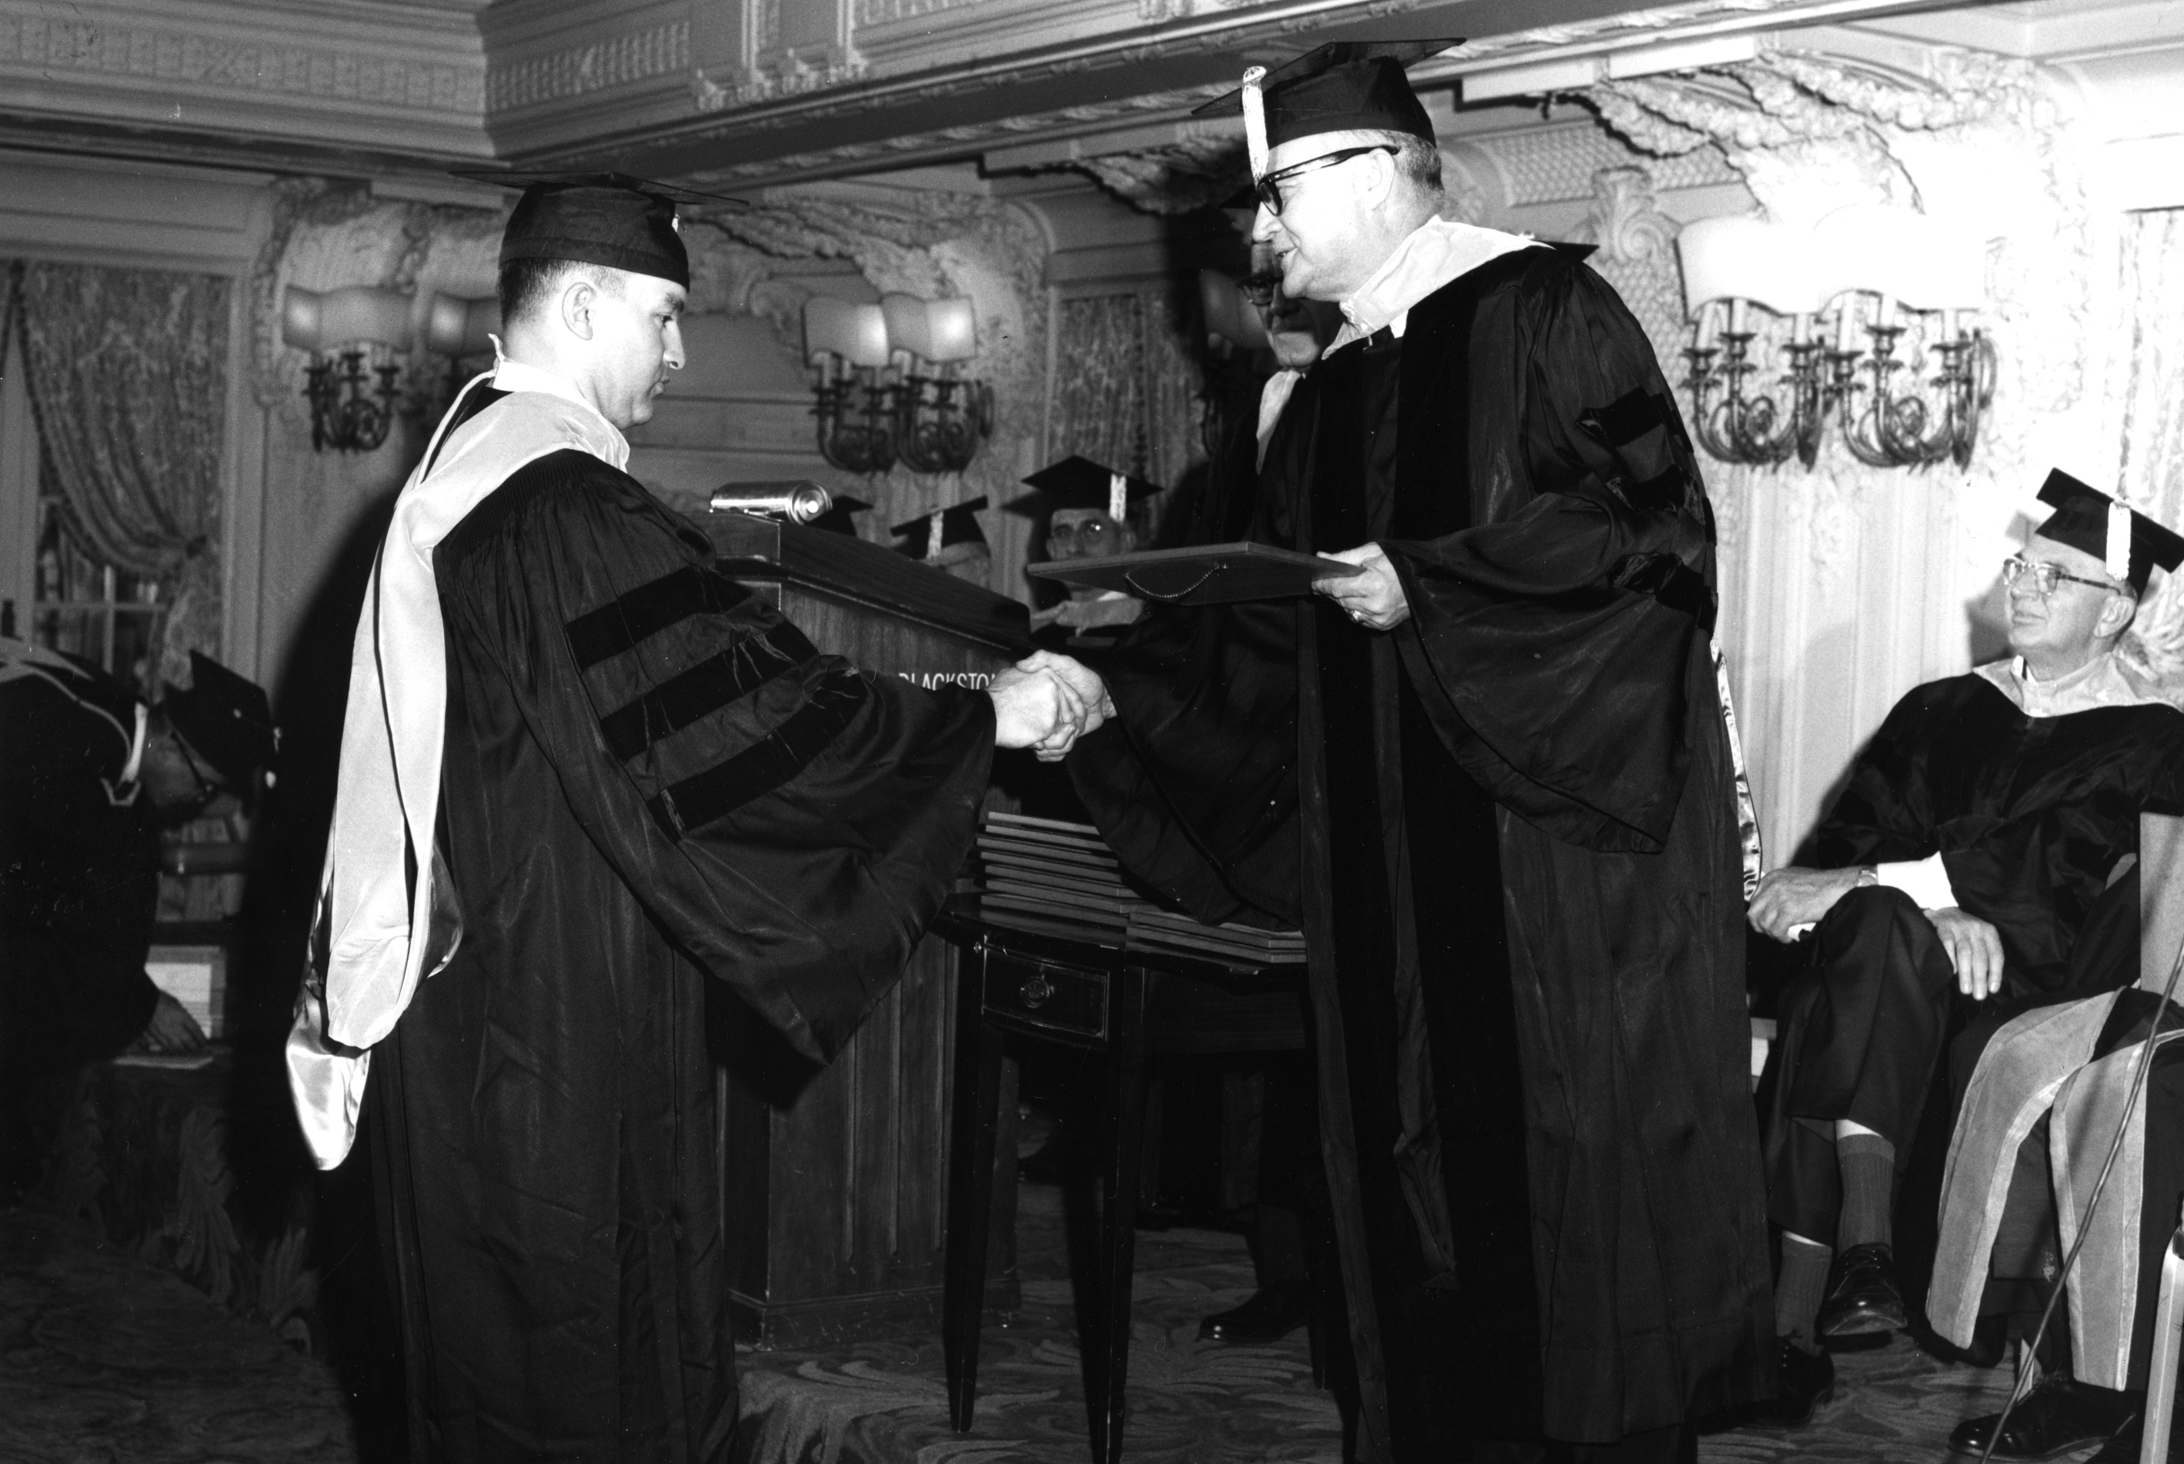
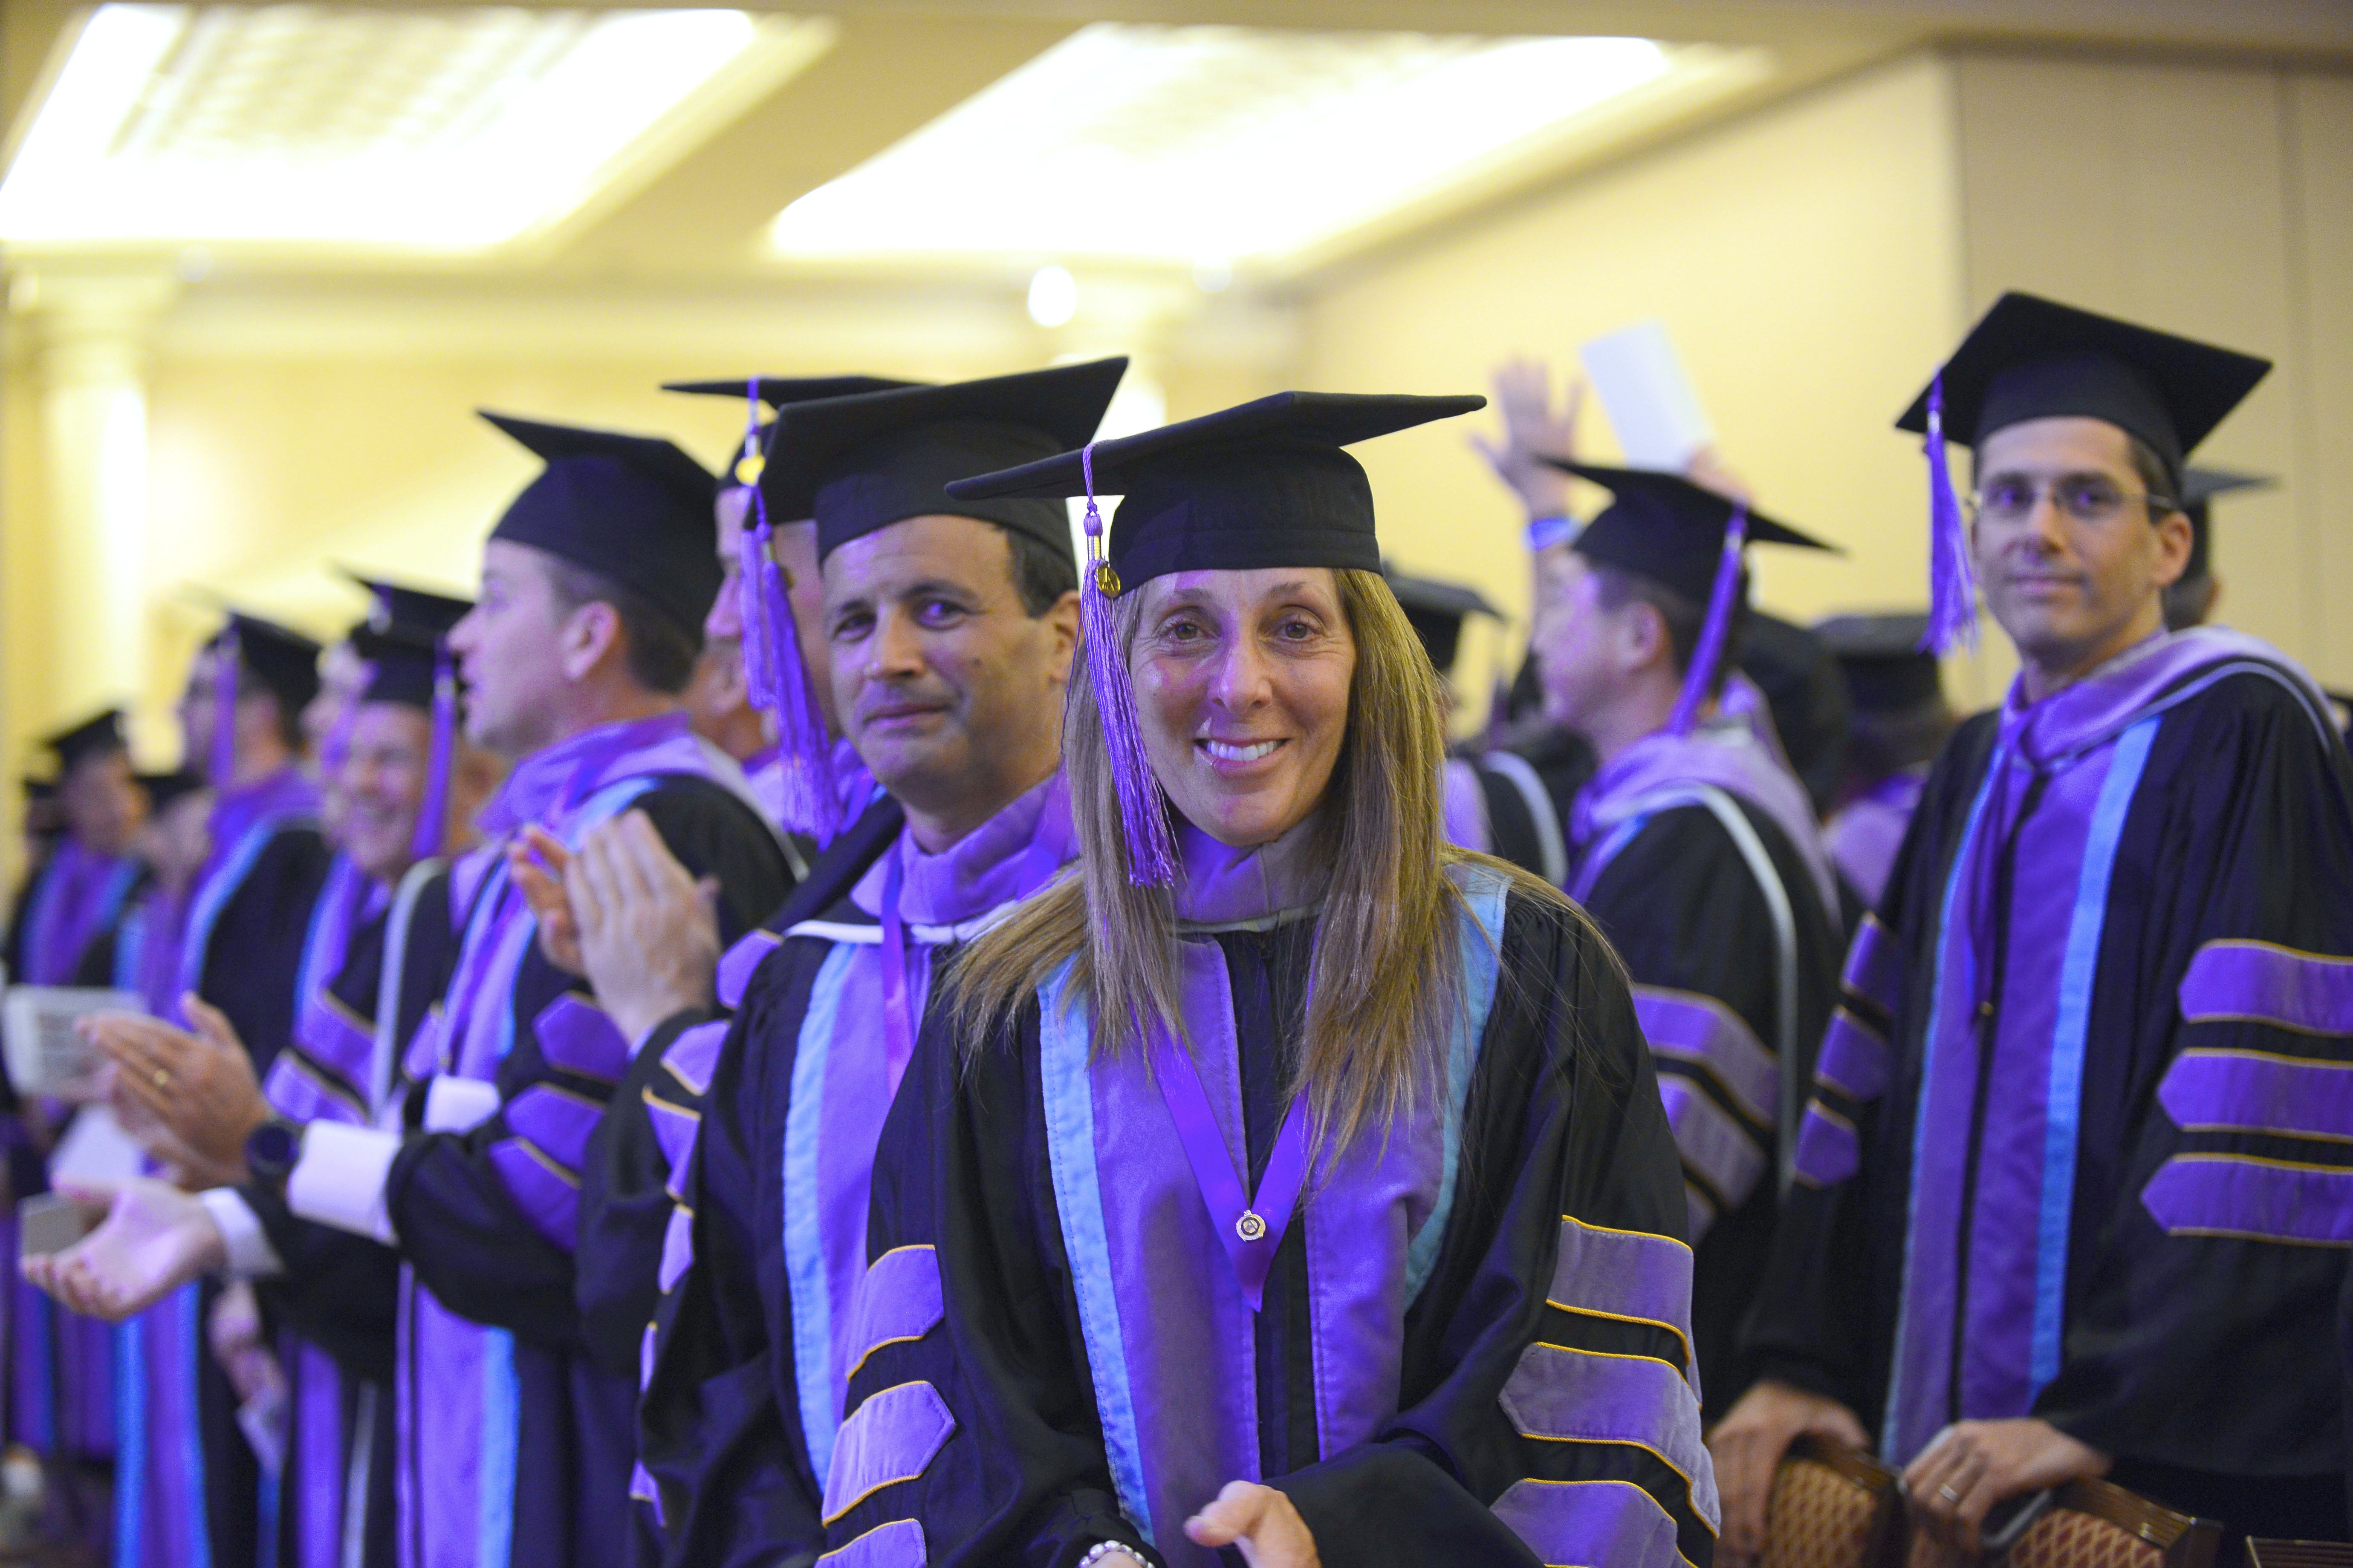
Fulfilling Our Purpose
AGD was founded on the belief that success as a general dentist is rooted in education, and that lifelong learning leads to healthy patients and thriving practices. Our commitment to education distinguishes us from all other dental professional societies.

Slide 4
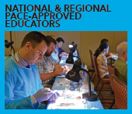
We promote lifelong learning through…
Resources for finding, earning and tracking CE from PACE-approved providers
Annual scientific session’s cutting-edge hands-on courses, and the ability to connect with thousands of peers
Local CE events
Notes:
With more than 1,900 providers approved worldwide, the AGD’s Program Approval for Continuing Education (PACE) ensures members ample CE opportunities to work toward an AGD achievement award or state relicensure. Achieve your professional and educational goals through these AGD CE opportunities:
AGD Scientific Session: The AGD Scientific Session offers the most up-to-date and practical continuing dental education (CE). With lectures and hands-on courses available, you’ll learn tips and techniques that will set you apart from the competition once you graduate. At the AGD scientific session, attendees can earn CE from conference sessions presented by a global faculty of dental experts, visit hundreds of leading companies showcasing the newest products and offering CE hours for FREE on the Exhibit Hall floor, and mix and mingle at a variety of exciting social events. The next annual meeting is June 7-9, 2018, in New Orleans. For more details, visit www.agd2018.org.
Local Program & Events: The calendar of events contains a current listing of programs and events happening in all constituents. Please be sure to check it on a regular basis, as it will serve as the source for the latest information. If you have questions about a listed program or event, please contact the organizer located in the event listing.
AGD CE Directory: The AGD highlights quality educational opportunities from providers throughout the world through our convenient, searchable database.

Slide 5
We promote lifelong learning through…
Six free on-demand webinars per year from a library of over 50 clinical and practice management webinars
Over 20 live clinical and practice management webinars
AGD Impact & AGD’s peer-reviewed clinical journal General Dentistry
Notes:
Free CE Program: Each year AGD members can access six free pre-recorded webinars through the Free CE Program
Self-Instruction: The Self-Instruction program is featured in the AGD’s bimonthly journal, General Dentistry. Each issue features three exercises, each worth two CE credits. You can use these credits toward relicensure (where self-examination credits are accepted), AGD membership maintenance, or the Fellowship award.

Slide 6
We promote lifelong learning through…
Recognition via AGD Fellowship, Mastership and LLSR awards
Regional study groups including Mastertrack programs
Notes:
AGD members distinguish themselves professionally through quality continuing education with Fellowship (FAGD) and Mastership (MAGD) in the AGD. Attaining your FAGD as well as your MAGD culminates with receipt of your award at the AGD convocation ceremony held each year at the AGD Annual Meeting & Exhibits.
The highest AGD honor, Mastership (MAGD), is a professional designation within the AGD beyond Fellowship. MAGD reflects a general dentist's ongoing commitment to provide quality care through continuing education.
Mastership recipients can then continue their dedication to lifelong learning and community service with the Lifelong Learning and Service Recognition (LLSR).
The AGD also recognizes members who make outstanding contributions to the profession and to the community through various awards, including the Distinguished Service Award, the Humanitarian Award, and the Dr. Thaddeus V. Weclew Award.
In addition, the AGD presents awards at the AGD Annual Meeting & Exhibits to Refer a Colleague Program top recruiters and various constituent award recipients.
Members can also recognize a fellow colleague’s achievements in general dentistry or their local constituent’s hard work by nominating them for an AGD Recognition Award.

Slide 7
Notes:
Wherever you are in your career — dental student, new dentist, mid-career or experienced dentists — AGD provides educational programming, opportunities for you to advocate for our profession, and a link for general dentists who want to connect with a strong and dedicated network of industry leaders.

Slide 8
Dental Students
Connect with peers and mentors by joining a local student chapter
Get help finding a residency program
Receive discounted or free registration to national education events
"When students become involved with AGD, they not only will have more professional opportunities, but also will have a voice to make decisions about their own future."
Cassandra R. Mora
Vernon Hills, Illinois
Member Since 2017
Notes:
Whether your goal is to create a foundation for lifelong learning, make professional connections or learn more about managing student debt, AGD has the resources you need to be successful in dental school and beyond. Your commitment to your education shows how serious you are about your career. AGD membership brings you one step closer to securing your future success. From continuing education and advocacy, to practice management and member connections, your opportunities to grow in your field before you even leave school are countless. Your membership also includes discounts on products and services, as well as free subscriptions to our newsmagazine, AGD Impact, and our peer-reviewed clinical journal, General Dentistry.

Slide 9
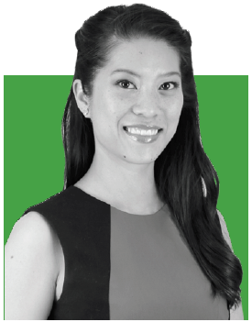
New Dentist
Connect with a mentor through the Mentor Program Directory
Refinance your student loan, or sign up for free professional liability insurance with Exclusive Benefits
Find your first job through Career Center
“As a new dentist, staying up-to-date with clinical skills and dental knowledge can get expensive. The best thing about the Free CE Program is that it offers complimentary education on topics that aren't covered anywhere else.”
Mai-Ly Duong, DMD, MPH, MEd, FAGD
Gilbert, AZ
Member Since 2012
Notes:
As a practicing dentist, your needs may have shifted from your days in dental school, but we know your commitment to success in your field is unwavering. For every step of your professional journey, AGD provides the resources you need to grow as a professional.
Your AGD membership includes tools for addressing student debt, practice management resources and networking opportunities that allow you to learn from the best in your field as you advance.
Laying the foundation for lifelong learning — and for earning recognition along the way — is also a top priority, and through our Online Learning Center, we make continuing education affordable and accessible.
In addition, study groups, local and national opportunities to engage with other members, and mentorship are all within reach for you, along with discounts on products and services, and free subscriptions to our newsmagazine, AGD Impact, and our peer-reviewed clinical journal, General Dentistry.

Slide 10
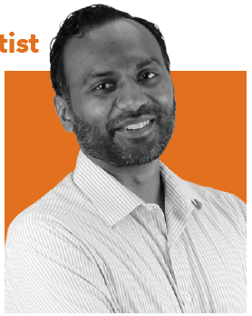
Mid-Career Dentist
Leadership opportunities within AGD
Discounts on business tools such as credit card processing, customer service training and website management
A library of AGD oral health fact sheets to help you keep your patients informed
"There are a number of courses available to us, but you know that by taking an AGD course, it is worth your money and, most importantly, your time.“
Chethan Chetty, DDS, FAGD
Los Angeles, CA
Member Since 2001
Notes:
You’ve established yourself as a general dentist, and your patients value both your experience and expertise. You’ve hit your stride professionally, have taken a good amount of CE and even mastered networking. So how else do you stay on top in your field?
Experienced dentists need opportunities to advance while maintaining busy practices. That’s why AGD offers high-quality, easily accessible CE and the chance to earn Fellowship, Mastership, and Lifetime Learning and Service Recognition awards. These honors tell the world how serious you are about staying at the forefront of learning in your field.
Through AGD membership, practice management tools and career advancement advice are also within reach. Volunteer leadership opportunities abound, as well as local and national networking events and opportunities to engage with other members.
For every stage of your career, we are dedicated to helping you navigate and excel as a general dentist.

Slide 11
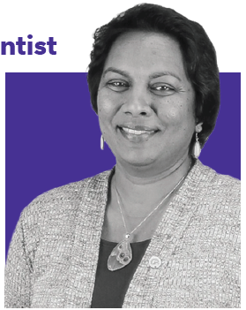
Experienced Dentist
Pursue AGD’s Lifelong Learning and Service Recognition award
Share your knowledge by becoming a PACE-approved AGD speaker
Transition toward retirement with practice resources
"I am accumulating credits toward my second LLSR because I love CE, and I wanted to show my family and my patients that I am constantly working toward improving myself."
Navin Bogg, DDS, MAGD
Roselle, NJ
Member Since 1994
Notes:
Whether your goal is to create a legacy for future dentists; make professional contributions to the field; or get more engaged through advocacy, leadership or mentorship, AGD has the resources you need to plan for retirement and beyond.
Your commitment to your education shows your dedication to your career, but also to general dentistry itself. To further that commitment, AGD membership brings you the opportunity to earn Fellowship, Mastership and Lifetime Learning and Service Recognition awards. These honors tell the world how serious you are about staying at the forefront of learning in your field and about your devotion to leadership.
From continuing education and advocacy, to practice management and opportunities to publish research in our peer-reviewed clinical journal, General Dentistry, the prospects for leaving your mark in the industry are countless.

Slide 12
Notes:
Explore member benefits. As the only organization exclusively dedicated to serving the interests and professional needs of the general dentist, AGD is uniquely qualified to offer you the exact resources you need to succeed in practice and promotion of quality oral health.

Slide 13
Continuing Education
Career Support
Member Connections
Tools and Resources
MEMBERSHIP BENEFITS
Exclusive Benefits
Advocacy
Awards
Publications
Notes:
From dental school to retirement, AGD offers benefits that cater to the changing needs of our members at every stage of their dental career. Our on-demand and in-person educational programs, special member savings, practice management tools, advocacy support resources, award-winning publications and the industry's only achievement-based awards for general dentists will help you distinguish yourself as the educated voice in oral health and dentistry.

Slide 14
Visit www.agd.org/JOIN-AGD
Contact AGD Membership Services membership@agd.org or call 888.243.3368
Notes:
Becoming a member of AGD and your local constituent is one of the most beneficial decisions you can make for enriching your career and enhancing the profession. Your participation makes AGD an invaluable organization for general dentists and students.

Slide 15
Questions?

Slide 16
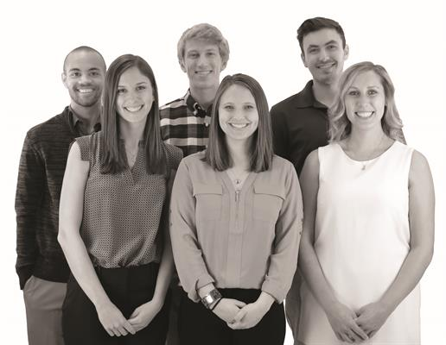
Thank You!

